Slide 1
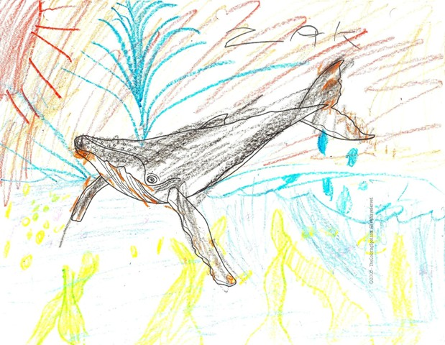
OCEAN and YOU provides models of 100 or so different marine animals, & coloring sheets to match. Kids are freed of the anxiety of drawing, & can observe the colors & textures of the animals quite closely. In this case, a second-grader named Zak noted the barnacles on the humpback whale. (He drew the seaweed in green; the yellow tint is a problem with my scanner).

Slide 2
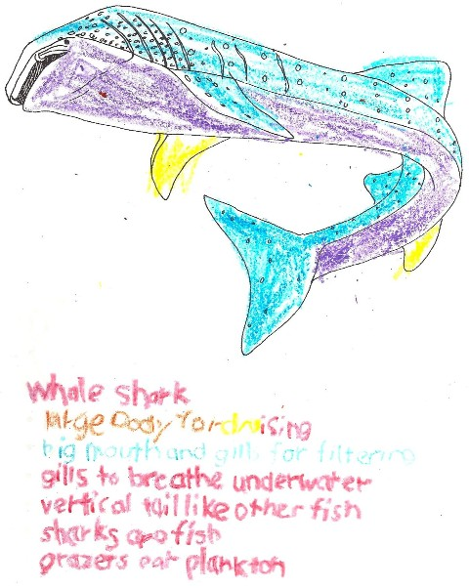
Marco, a first grader, colored this whale shark, & traced the words describing the animal’s adaptations. I was a bit surprised to find that kids from Kindergarten to Fourth grade enjoyed this activity.

Slide 3
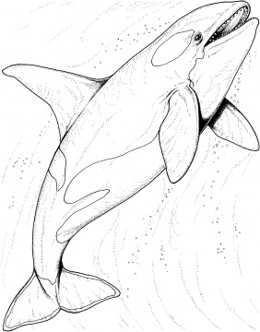
Killer Whale
sleek body for fast acceleration
pointy nose and lots of teeth for biting
blowholes to breathe above water
flat tail like other whales
whales are mammals
hunters eat seals & fish

Slide 4
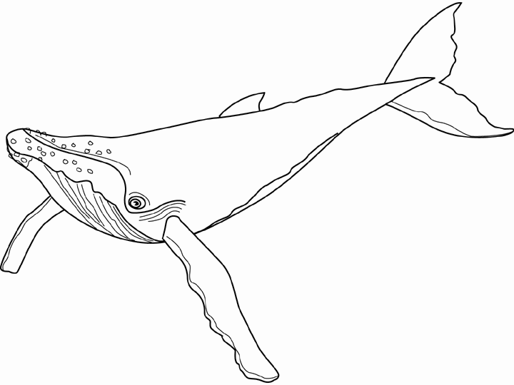
Humpback Whale
large body for cruising
big mouth and baleens for filtering
blowholes to breathe above water
flat tail like other whales
whales are mammals
grazers eat plankton

Slide 5
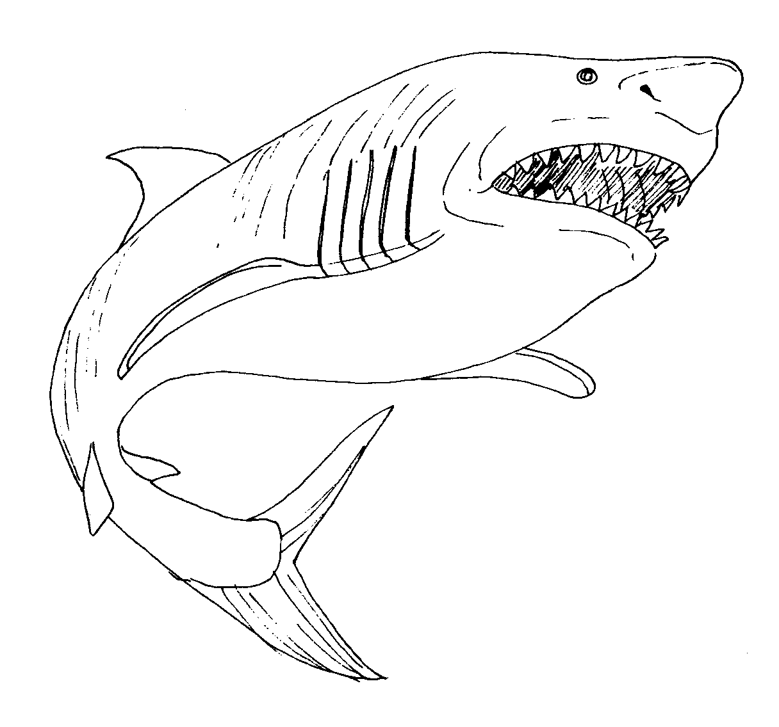
Great White Shark
sleek body for fast acceleration
pointy nose and lots of teeth for biting
gills to breathe underwater
vertical tail like other fish
sharks are fish
hunters eat seals & fish

Slide 6
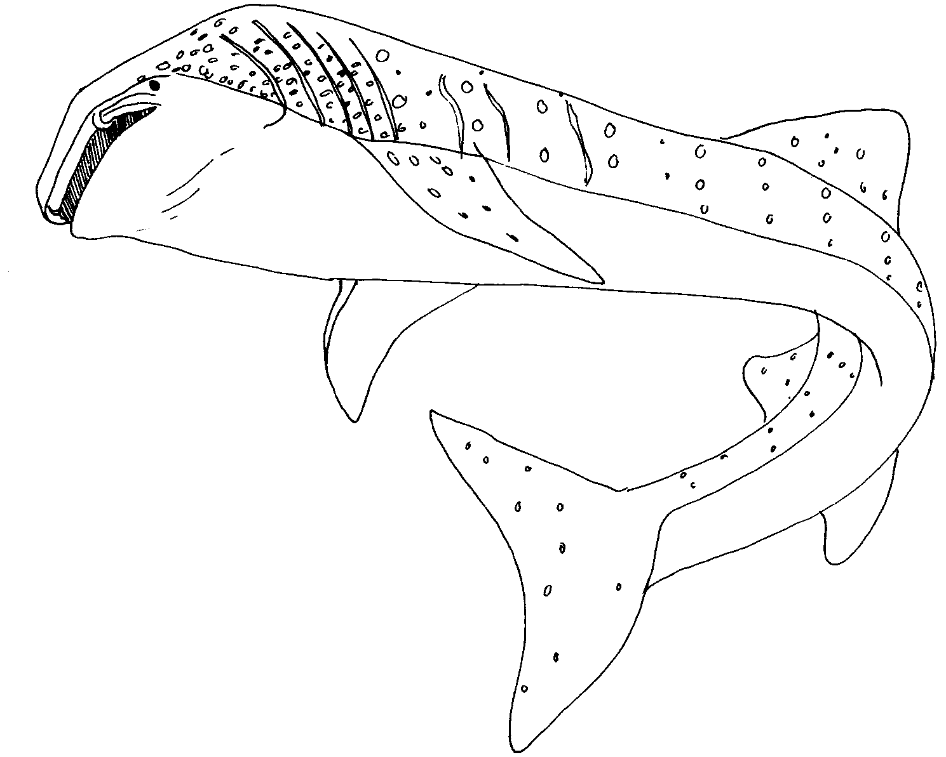
Whale Shark
large body for cruising
big mouth and gills for filtering
gills to breathe underwater
vertical tail like other fish
sharks are fish
grazers eat plankton

Slide 7
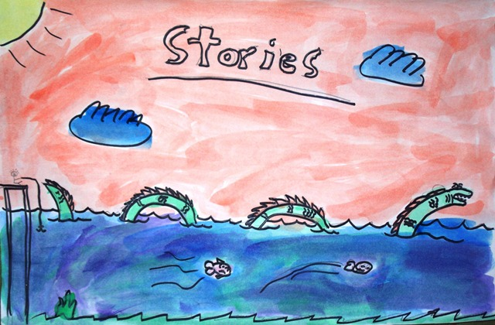
I asked the kids to paint something they like about the ocean.
Many were inspired by my story about a sea serpent.

Slide 8
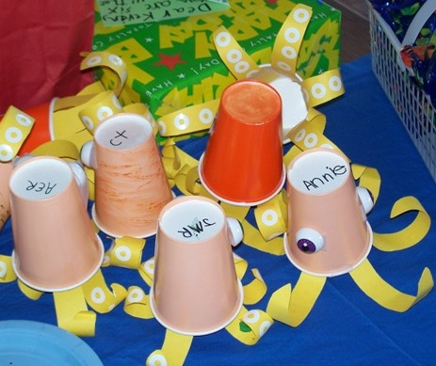
Octopus’ bodies are paper cups, of course.
Construction paper legs are precut for small kids. Roll on a pencil to curl.
Use binder paper reinforcements for suckers.
Eyes are huge; I happened to luck into some human-eyeball confetti for Halloween. Google eyes should be at least 1” in diameter.

Slide 9
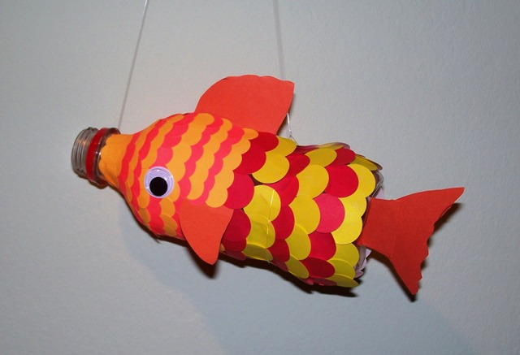
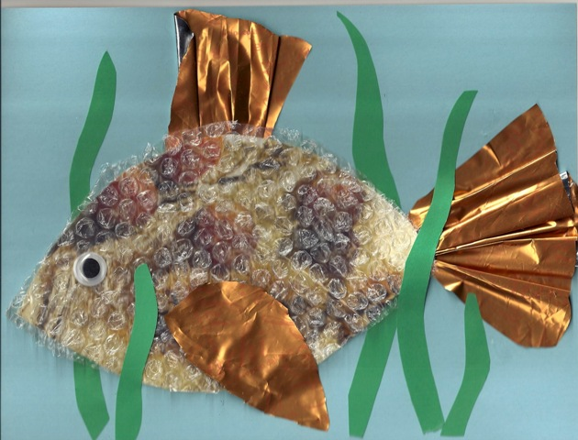
Fish is a plastic soda bottle with cardstock fins.
Most people use paint for the scales. I tried sticky dots, but the big ones didn’t stay stuck.
Fish collage from trash: A box of candied chestnuts, bubble wrap and a google eye.

