Slide 1
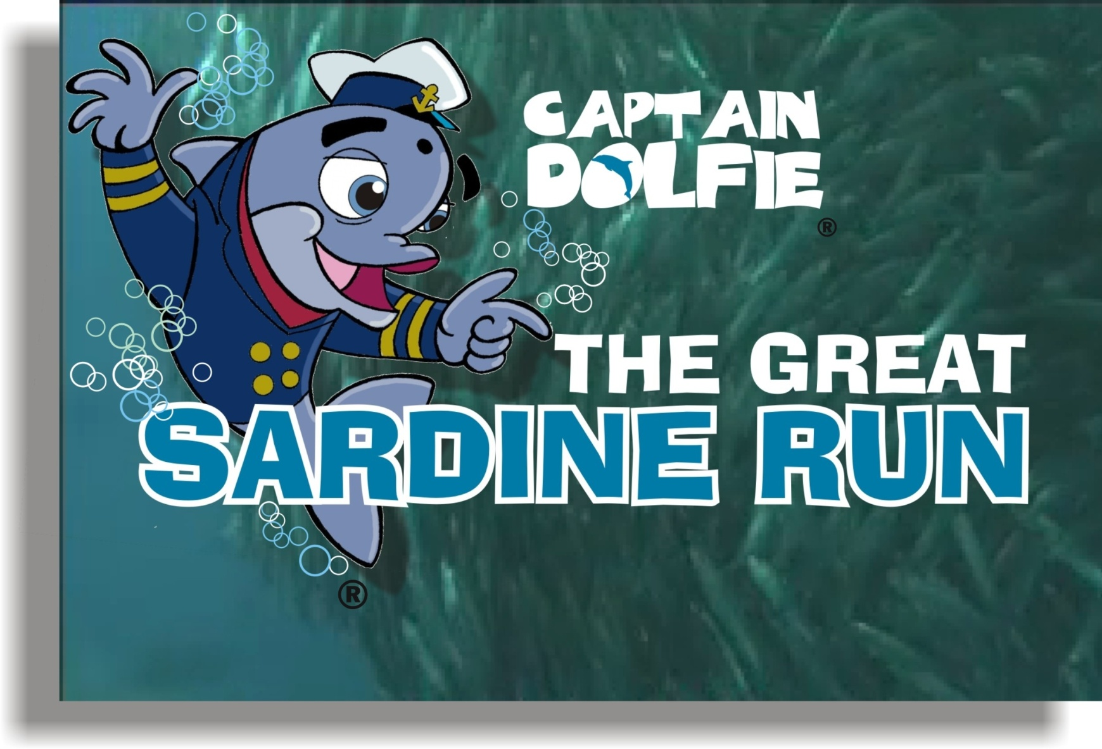

Slide 2
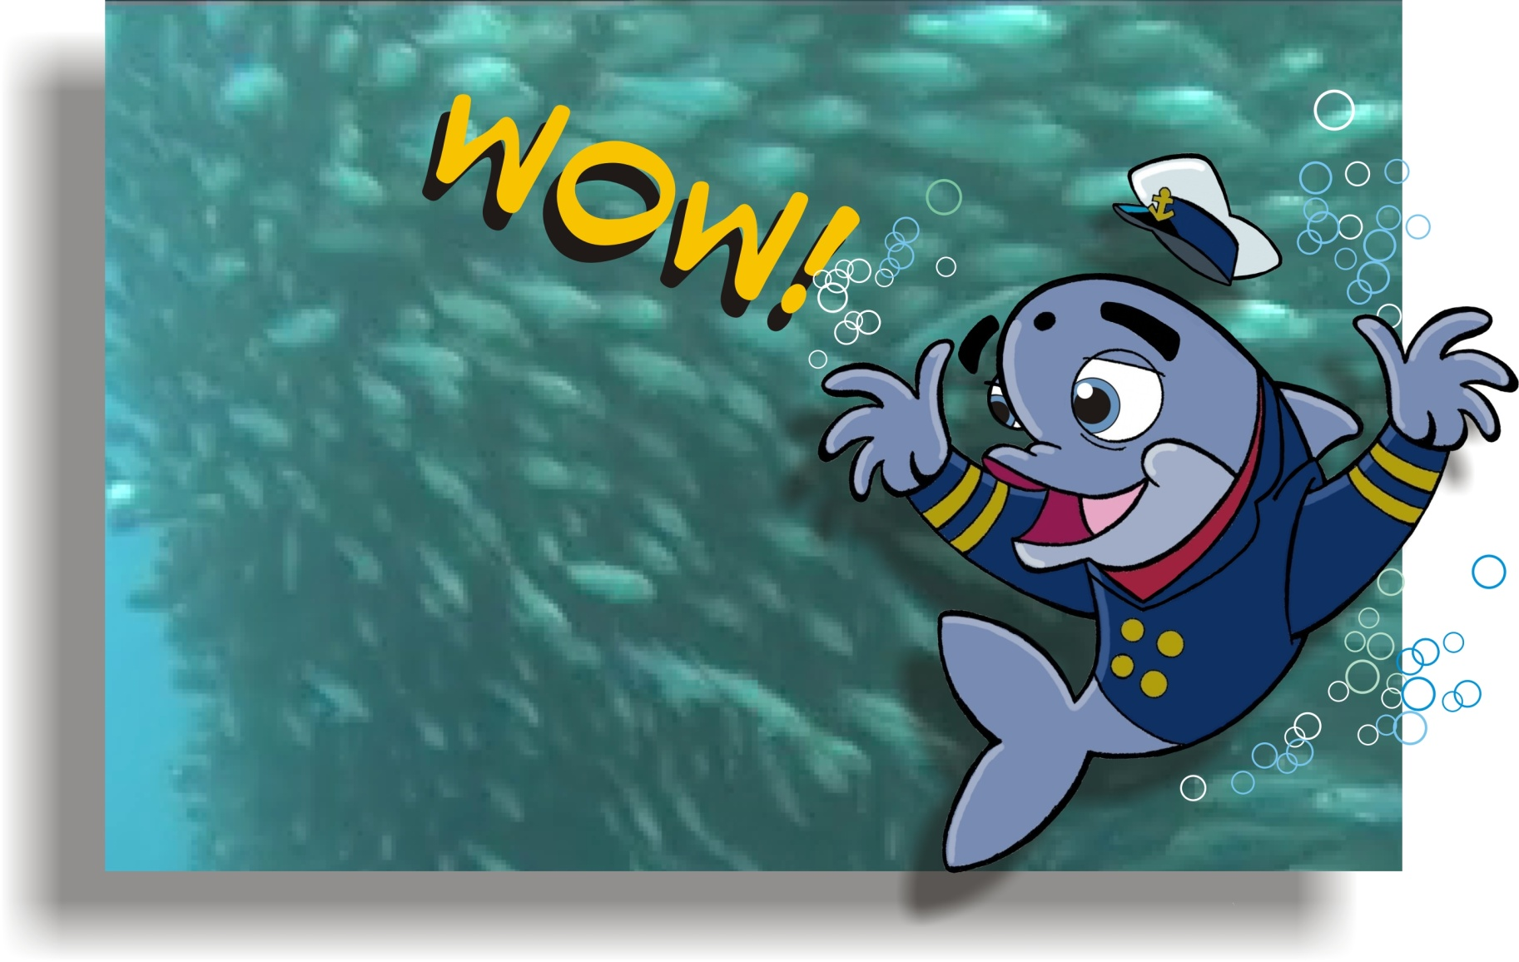
‘WOW... The Sardines have arrived’
Dolfie, spots the arrival of the giant Sardine shoals (Live footage) moving up the South African
Kwa-Zulu Natal coast

Slide 3
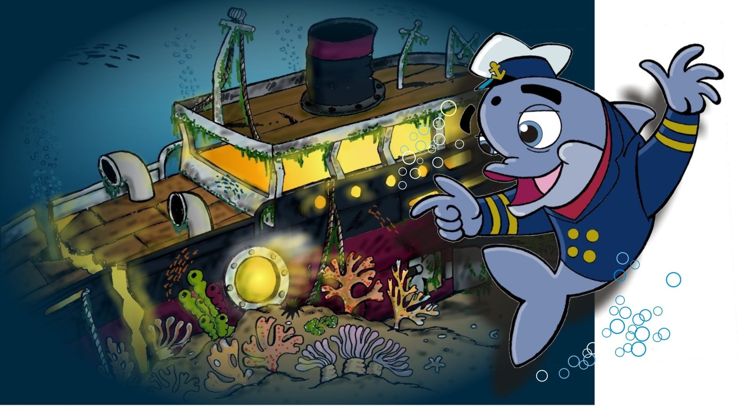
‘I must visit Professor Brindle Brain, the Great Bridle Bass and ask him to tell me more about one of the greatest Marine Events on earth’
Dolfie, visits Prof. Brindle Brain who lives in an old sunken wreck.

Slide 4
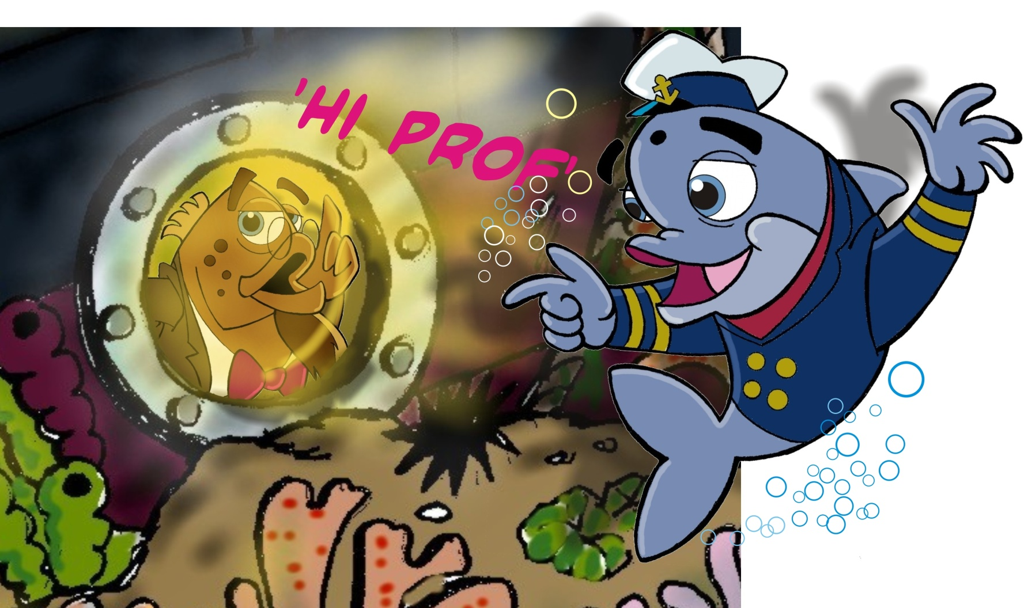
‘Hi Prof... You won’t believe it ...the little silver fish have arrived!
I need to get a deeper understanding...um...um...’
Dolfie, knocks on Prof. Brindle Brains port hole.

Slide 5
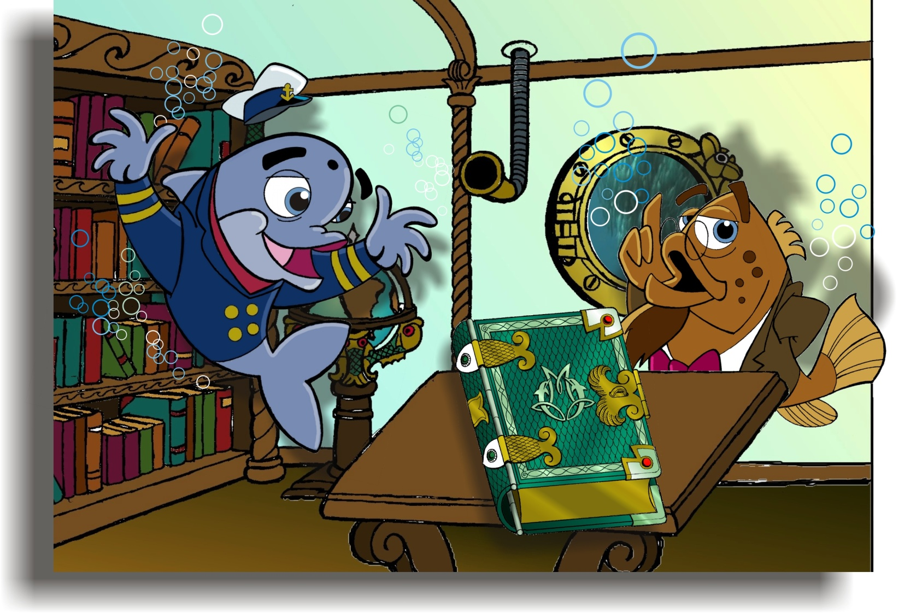
Prof; ‘Hmm...yes knowledge is power.
Come in, come in... Shall we look it up in the GREAT BOOK?’
Dolfie, and The Professor look in the Great Magical Book of the Ocean that contains all the answers to its mysteries and marvels.

Slide 6
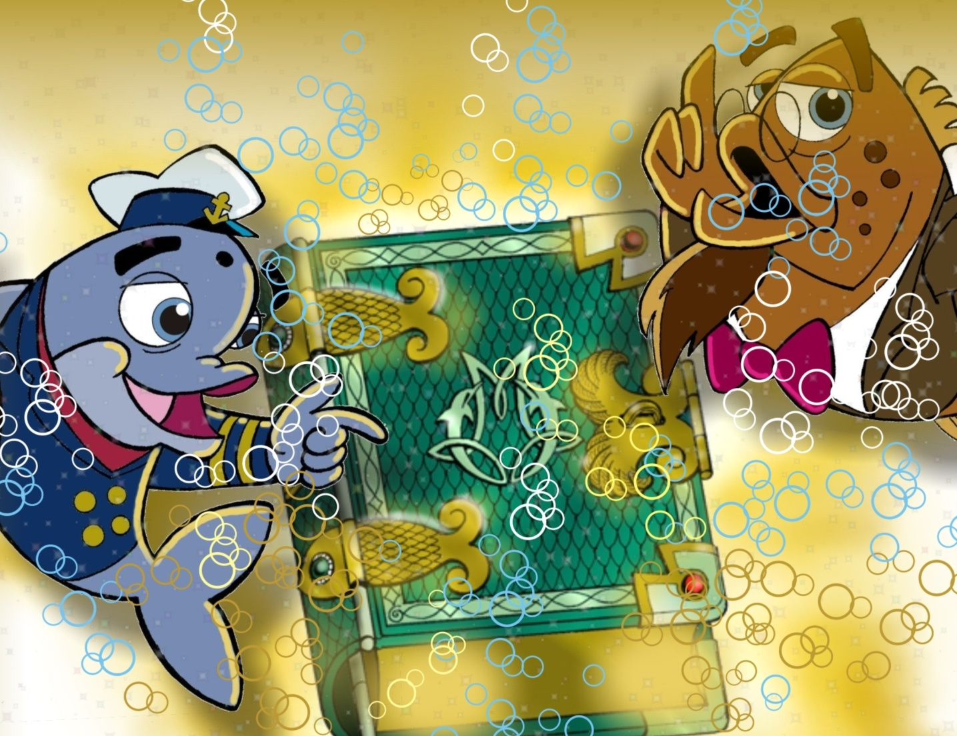
As they open the Great Book it comes to life by omitting bright flashes of light and bubbles like a percolator.

Slide 7
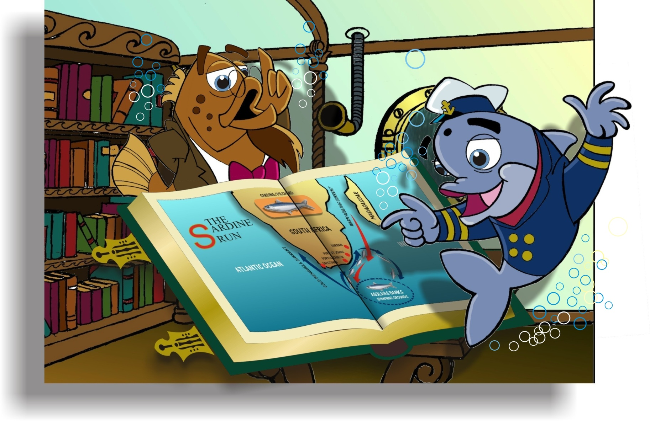
They open the Great Book where a graphic illustrates the migration of the giant shoals up the coast and back to their spawning grounds.

Slide 8
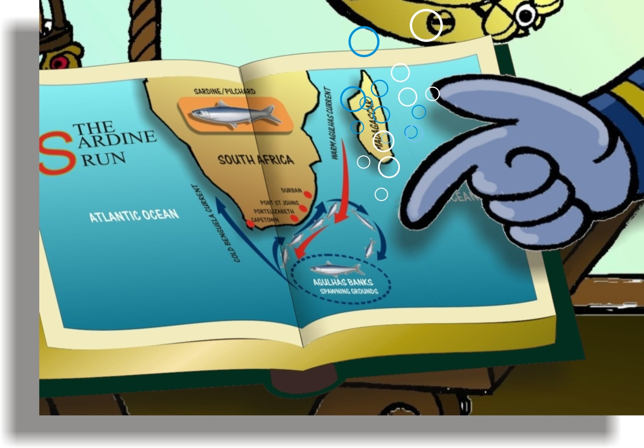
‘Look how the seasonal ocean current shift, influences this magnificent migration.’

Slide 9
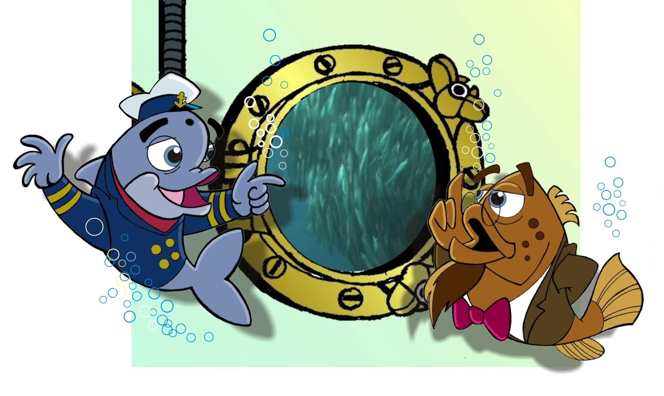
‘Let’s watch this amazing journey through the port hole and see how it changes into chaos’
Dolfie, and Prof. Observe (Live footage) the giant migrating shoals through the big port hole.

Slide 10
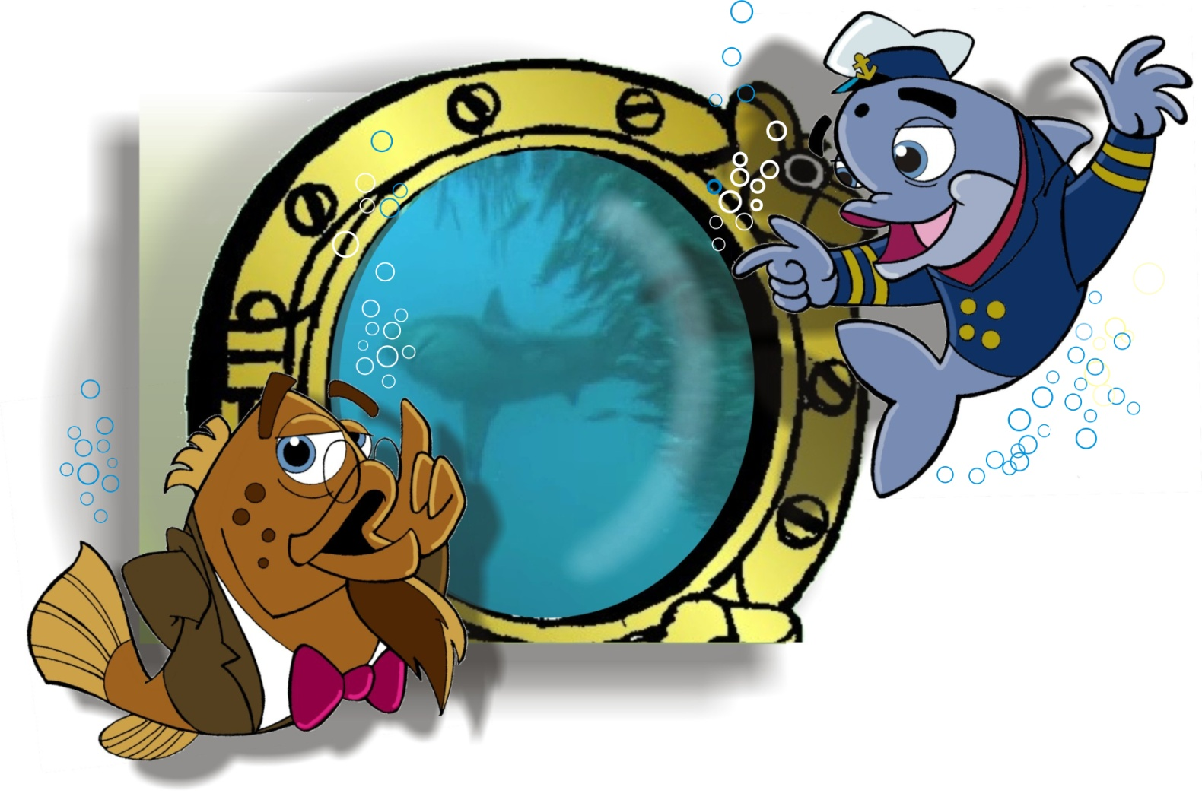
‘It looks like a huge fast food tornado moving through the ocean as they are continuously attacked by predators’
Dolfie, and Prof. Watch (Live footage) as Shark’s, Whales, Dolphins and Sea birds attack the shoal from all sides.

Slide 11
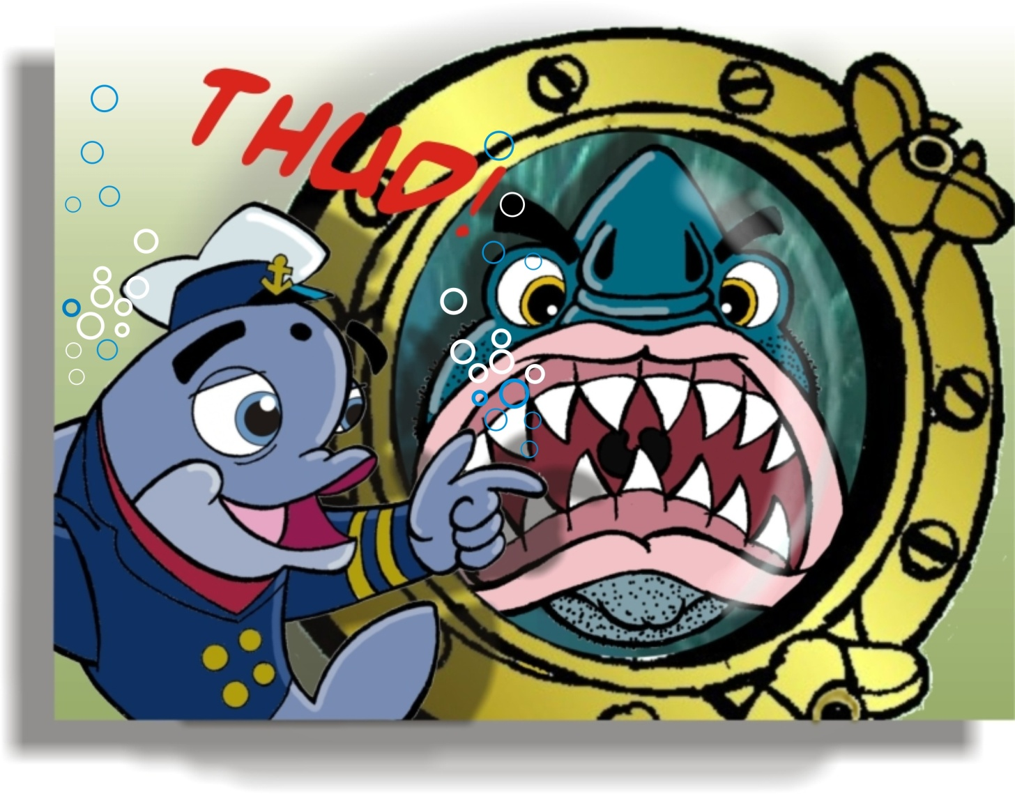
‘The ocean is not a place for sissy’s!’
Big Whitey; Never forget who’s at the top of the food chain...
BOOM...Big Whitey (The Great White Shark) swims up against the port hole glass with a loud thud! (Live footage in the back ground) .

Slide 12
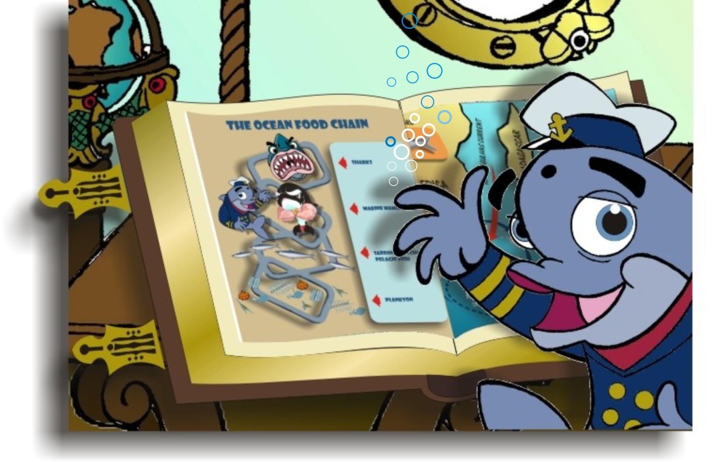
Dolfie, looks in the Great Book at the graphic that illustrates the Ocean’s Food Chain hierarchy.

Slide 13
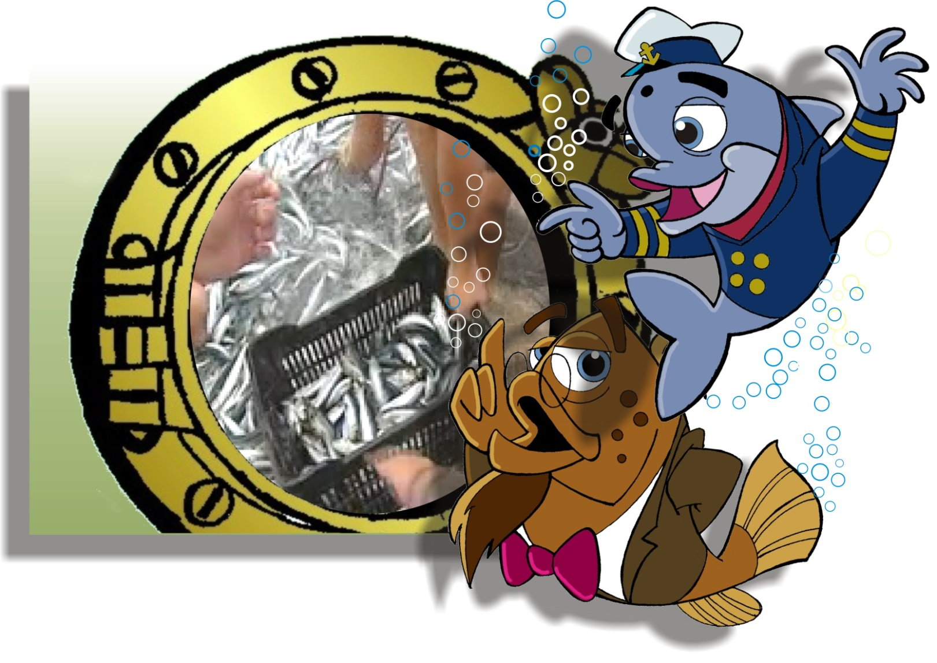
‘Look Prof...There’s not only a feeding frenzy under water! The landspeople are scooping up as many of the little silver fish with anything they can find ’

Slide 14
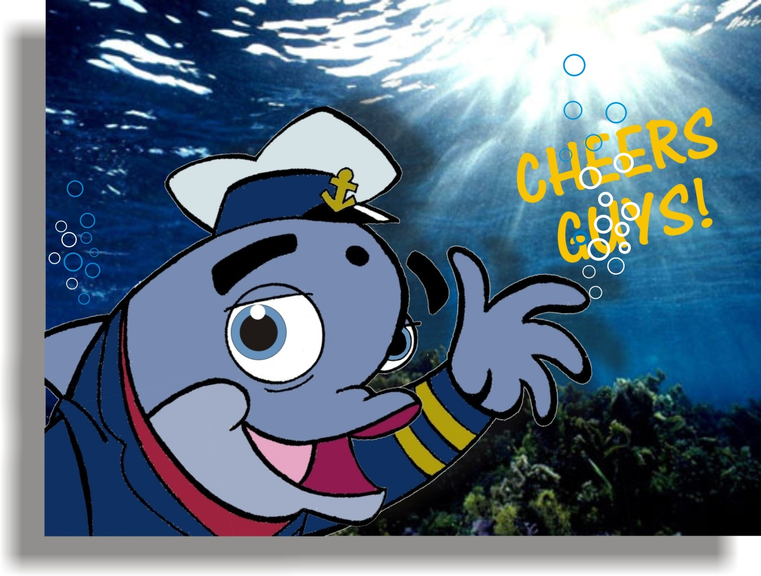
‘Thanks guys, for joining me in this exciting journey in one of the earths most amazing events.
Remember always appreciate and protect your wonderful environment and always have an OCEAN ATTITUDE!’

