Slide 1
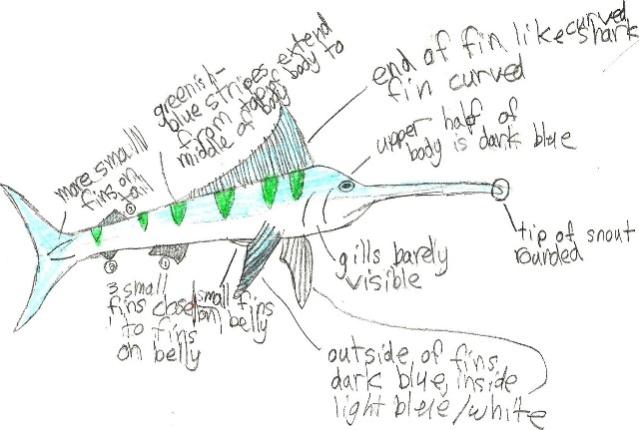
Field notebook of a model swordfish, by Keon, age 10
This is the best way to encourage close observation. Be sure to
provide examples, like the ones on the next few pages.

Slide 2
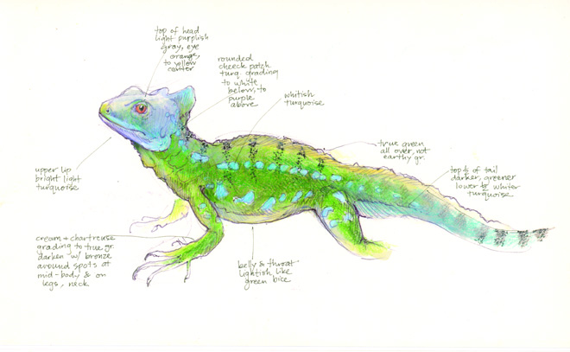
http://openlabresearch.com/archives/1162
Beautiful Data: The Art of Science Field Notes
Jenny Keller, copyright 2010
That science has benefited immensely from technological advances in the last few decades, or even the last century, is a fact. But one research tool that many scientists would argue need not be improved is the handwritten field notebook.

Slide 3
