Slide 1
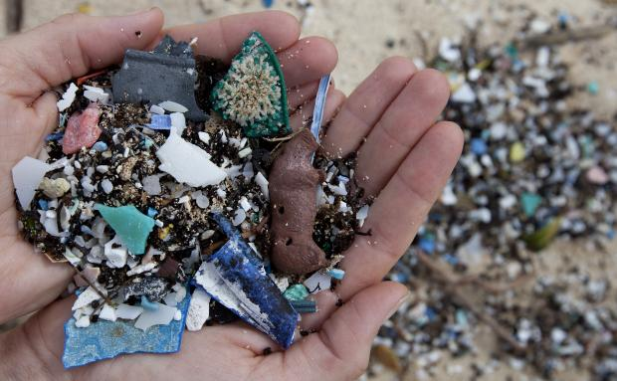
Microplastics In the Ocean
By:The LA Microplastics team

Slide 2
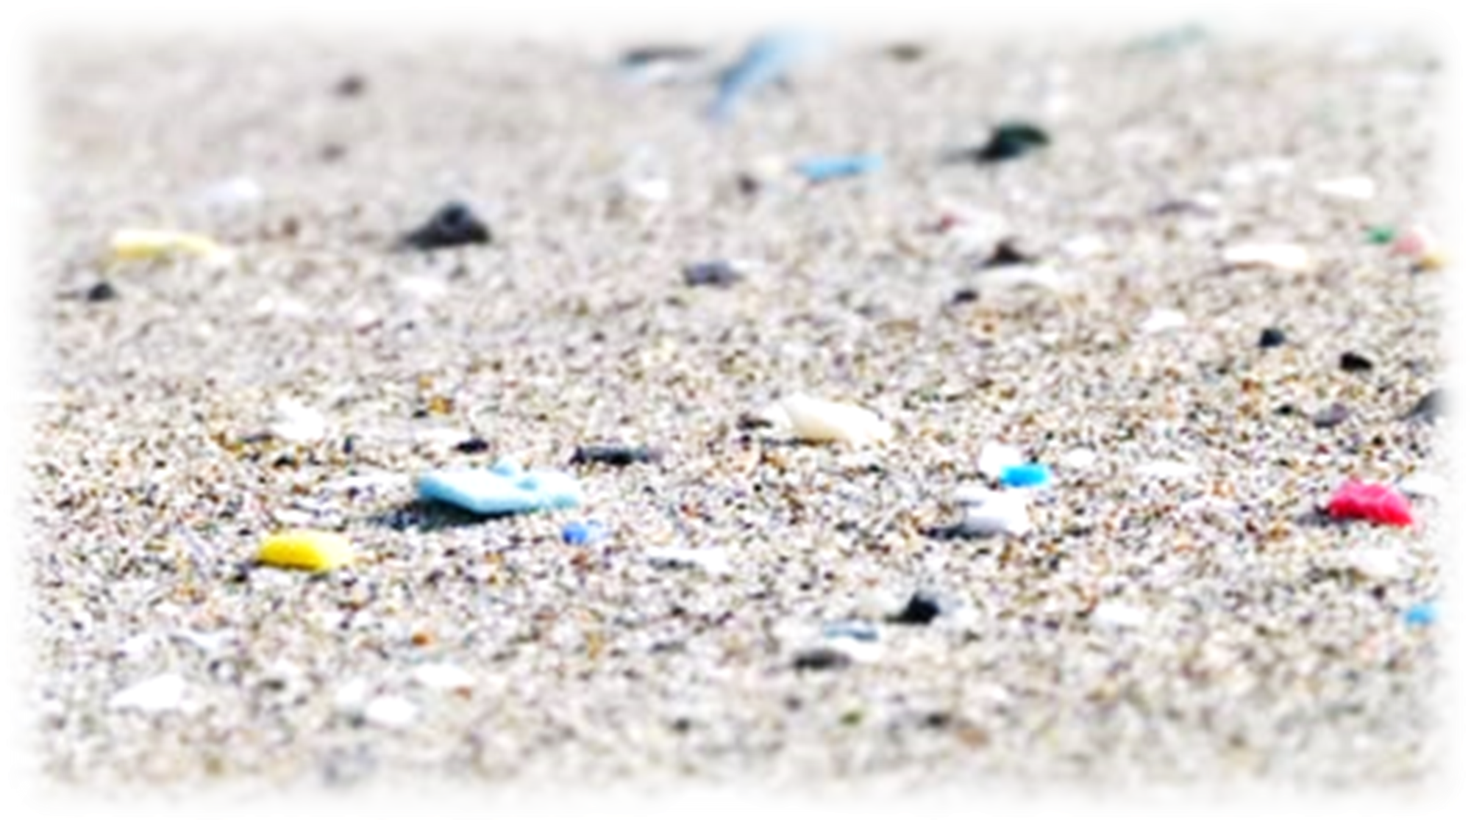
Study of micro-plastic distribution
JAPAN: Mai Amitani, Daichi Saito, Mai Shigeta, Mikinori Matsui, Toochi Uno, NakanoYuta Inoue, Shiho Suzuki, Yuka Matsuyama, Hina Shimada, Akiho Matsumiya US: Kevin Zepeda, Melissa Zepeda, Johanna Cervantes, Diana Cervantes, Maria Tellez, Sinaí Pacheco, Jessica Gonzalez, Briceida Montes, Jose Velasquez, Linda Morales

Slide 3
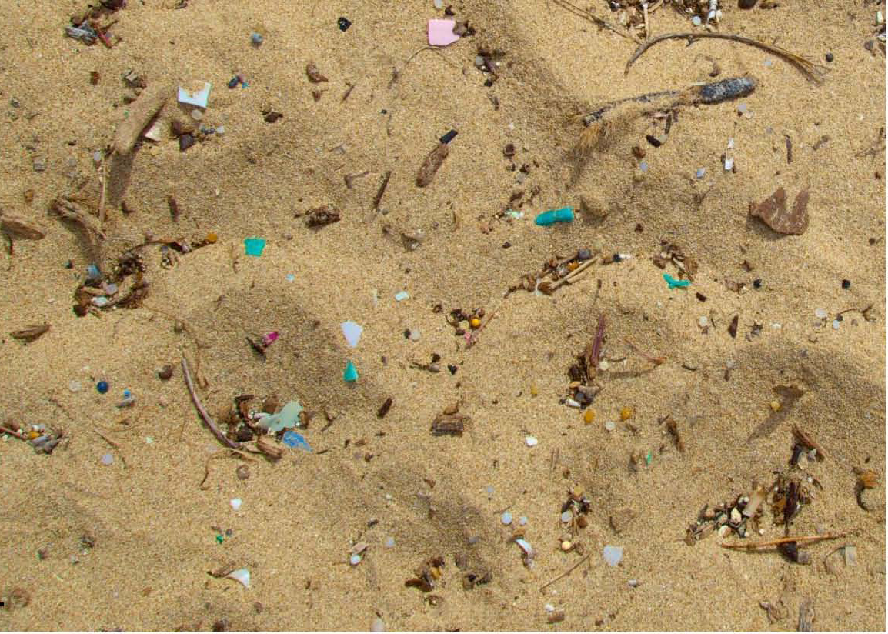
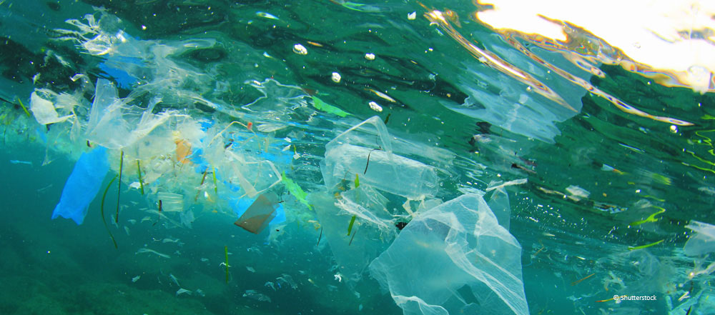
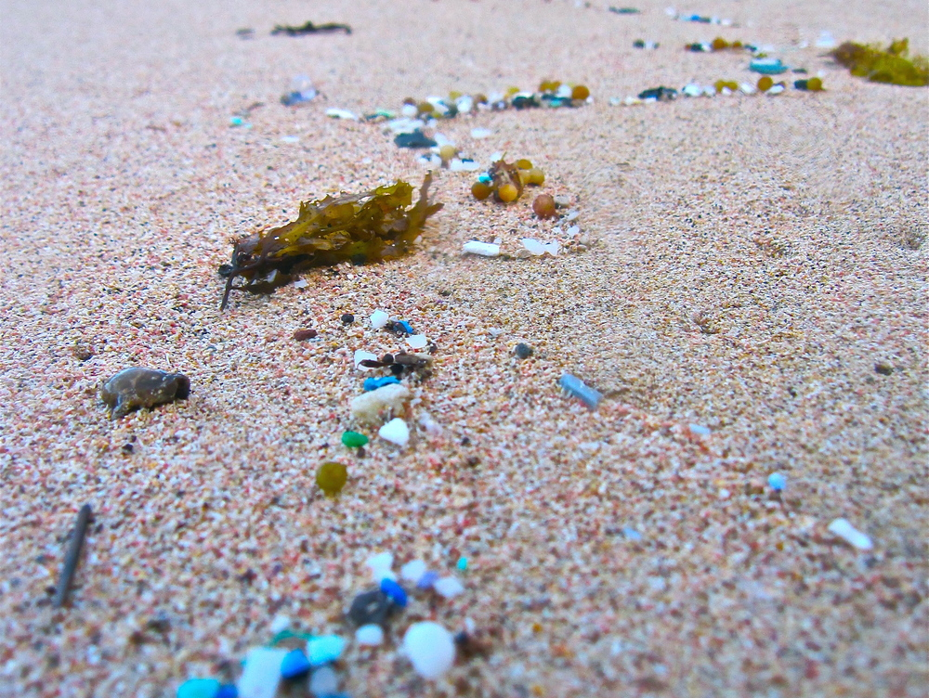
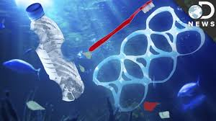
How do Microplastics Enter Earth’s Oceans?
-Littering
drain sewers, garbage dumps
-Reaches oceans,rivers
-Plastics deteriorate until remains are tiny particles
-Suspended in sand, water
Our mission is to spread knowledge and awareness of microplastic debris and the impact in terms of both marine and human environments. We want to inspire action within the general public to force changes.

Slide 4
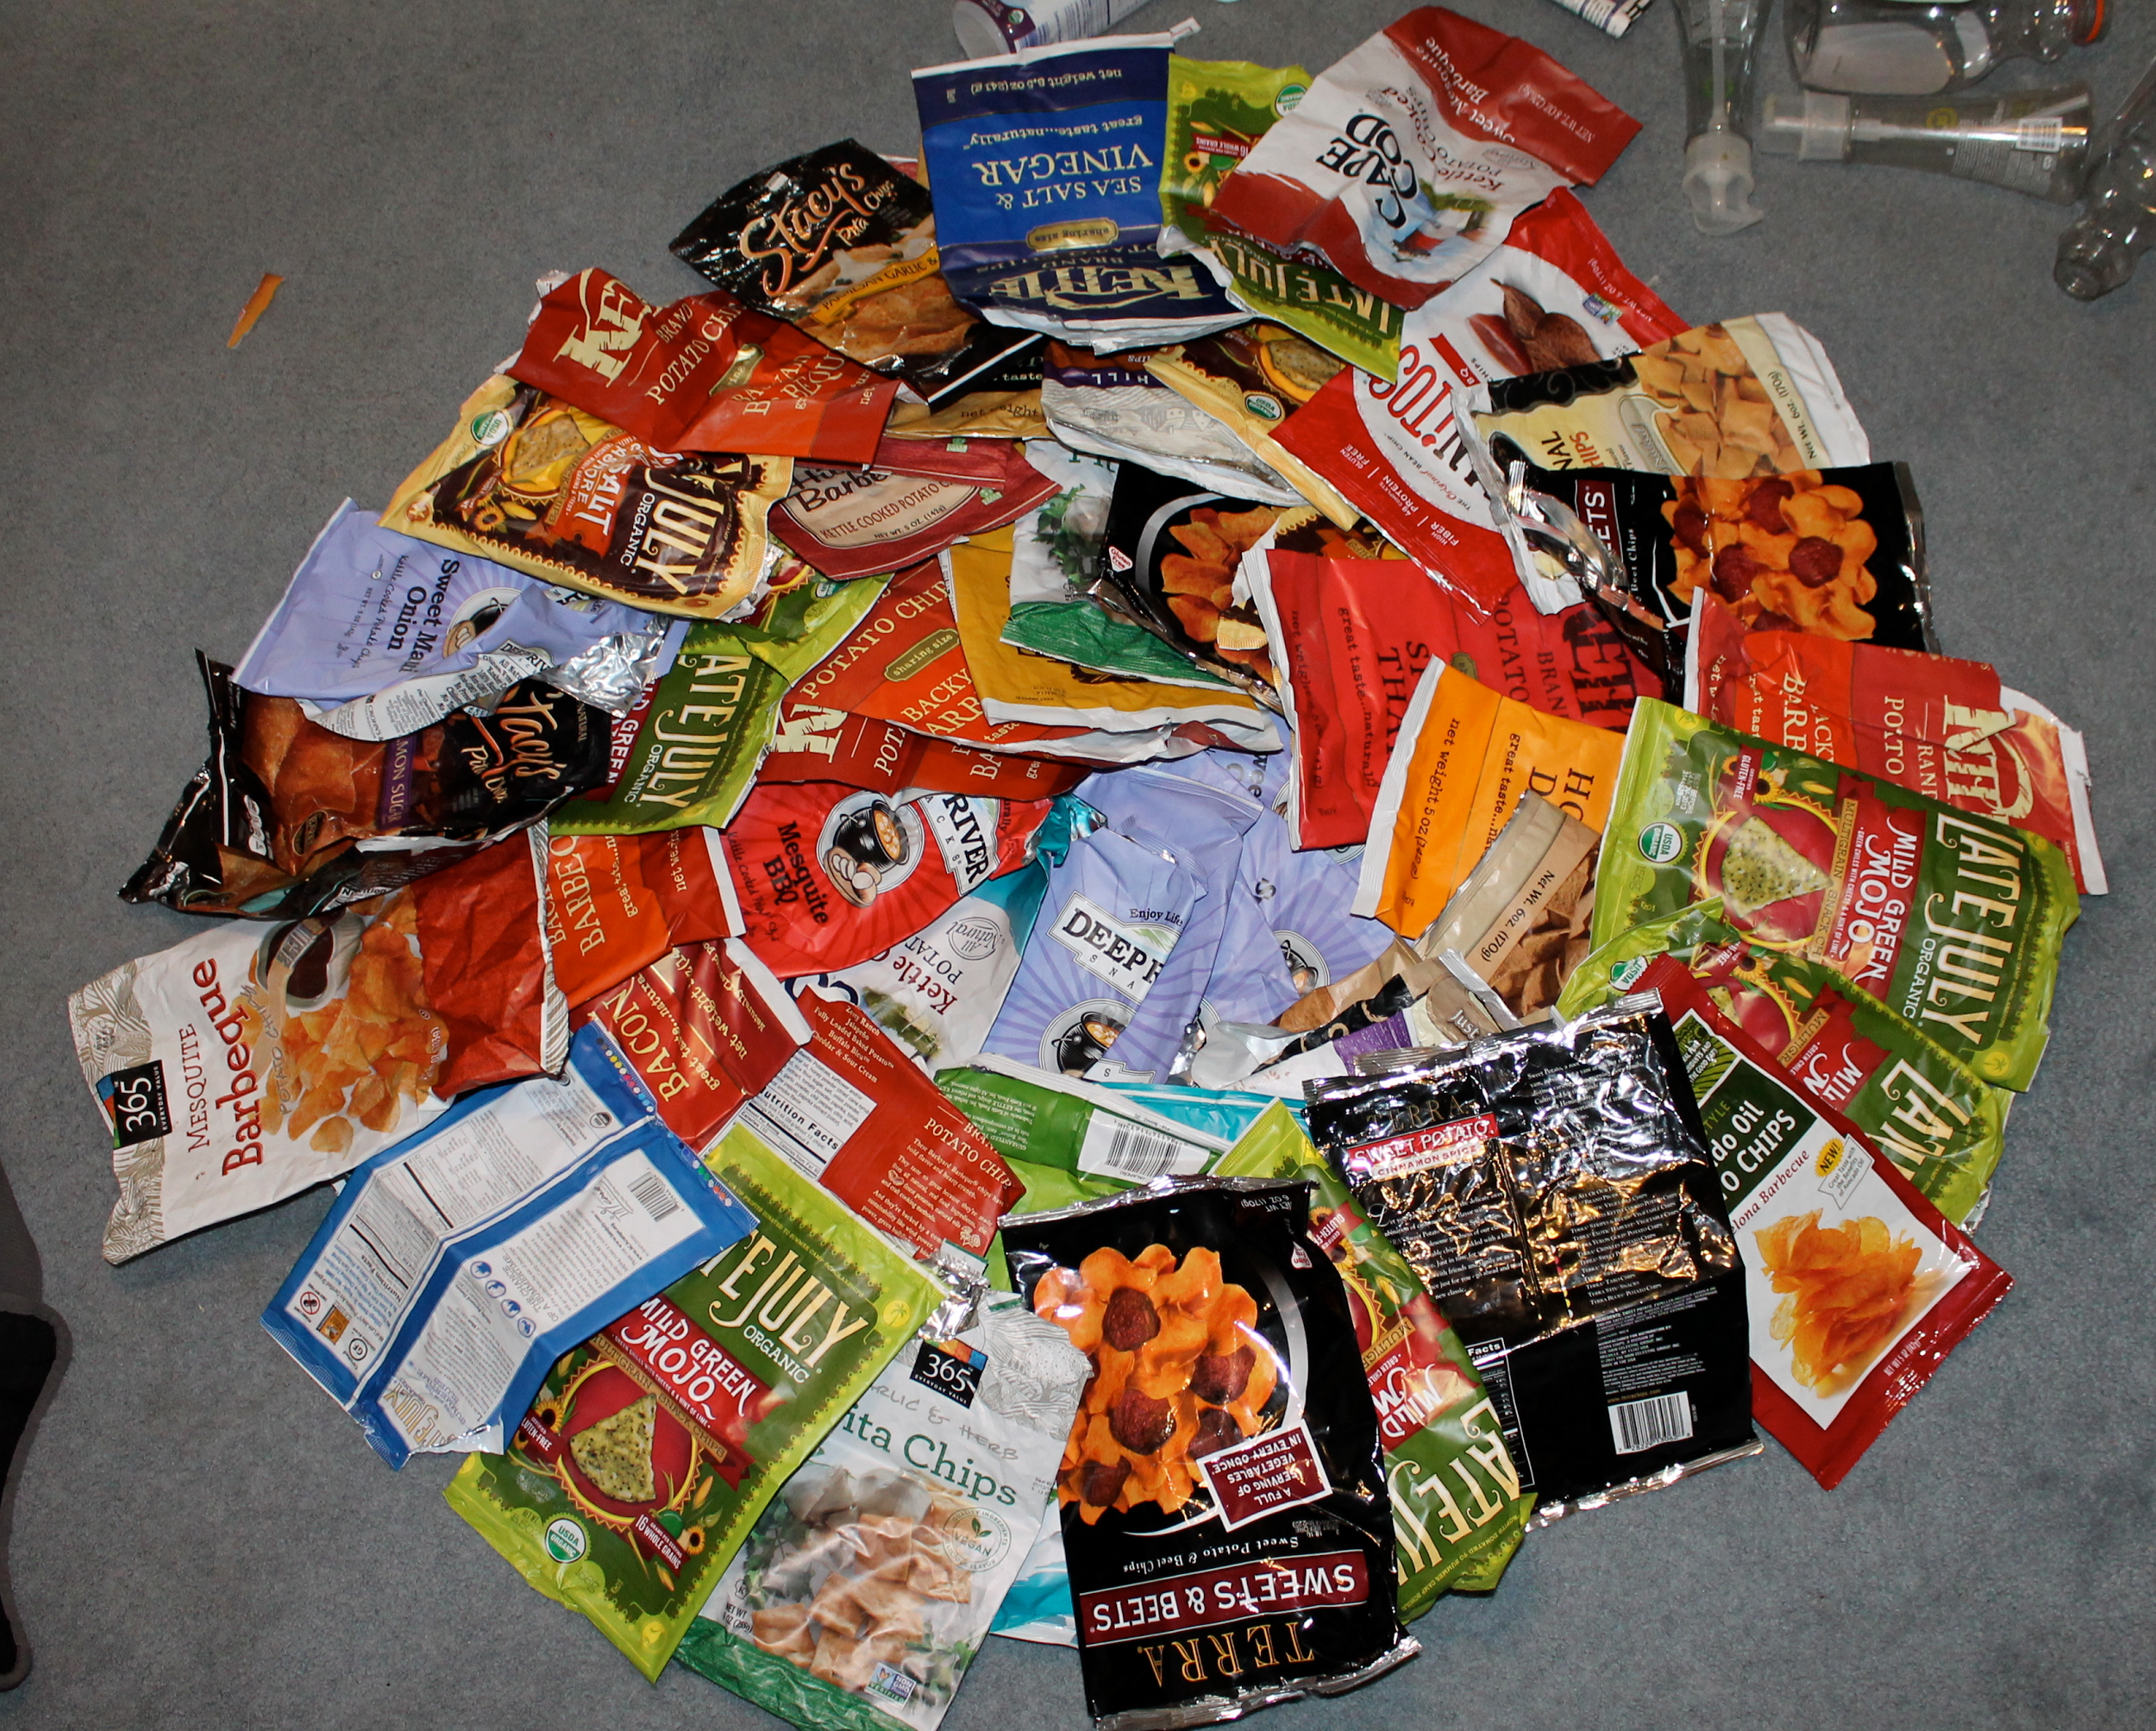
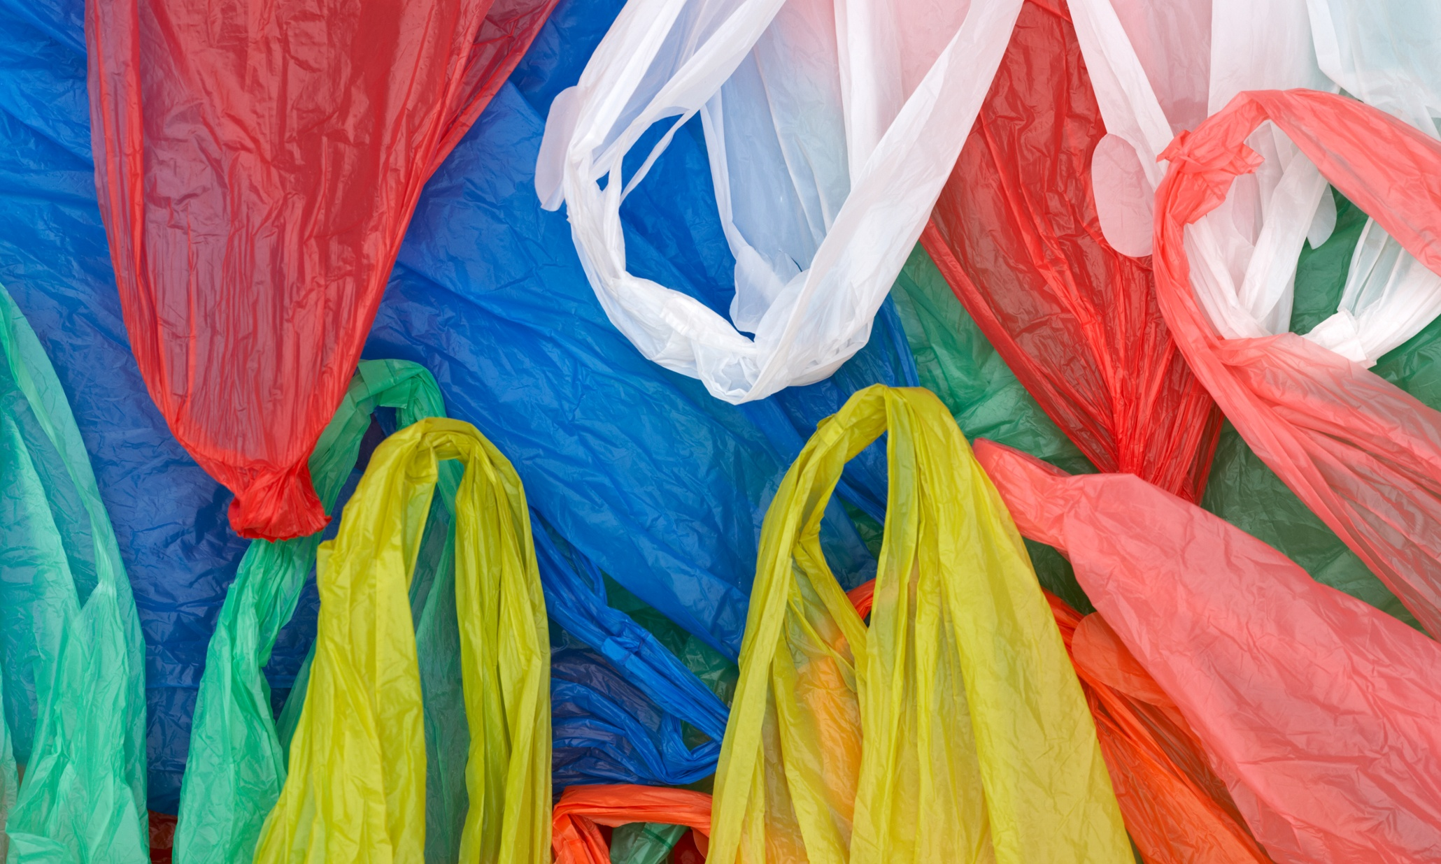
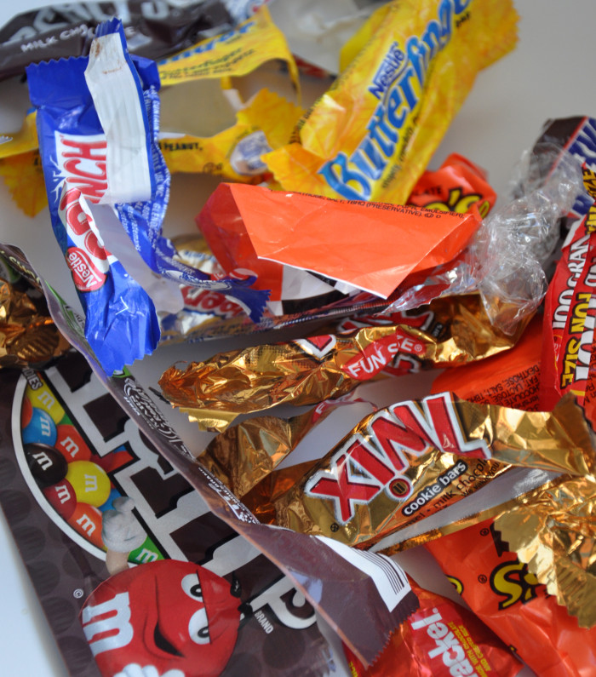
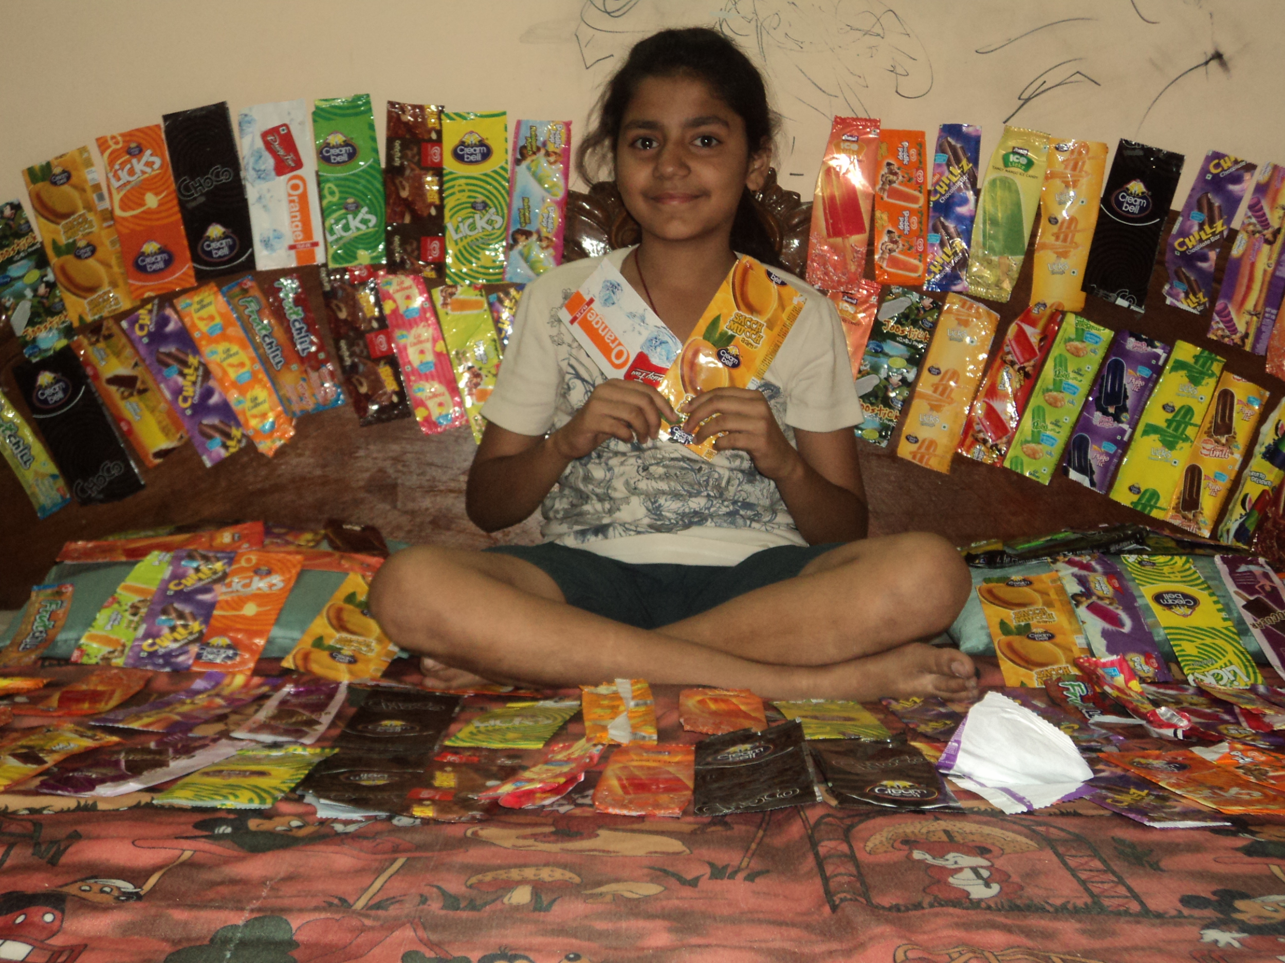
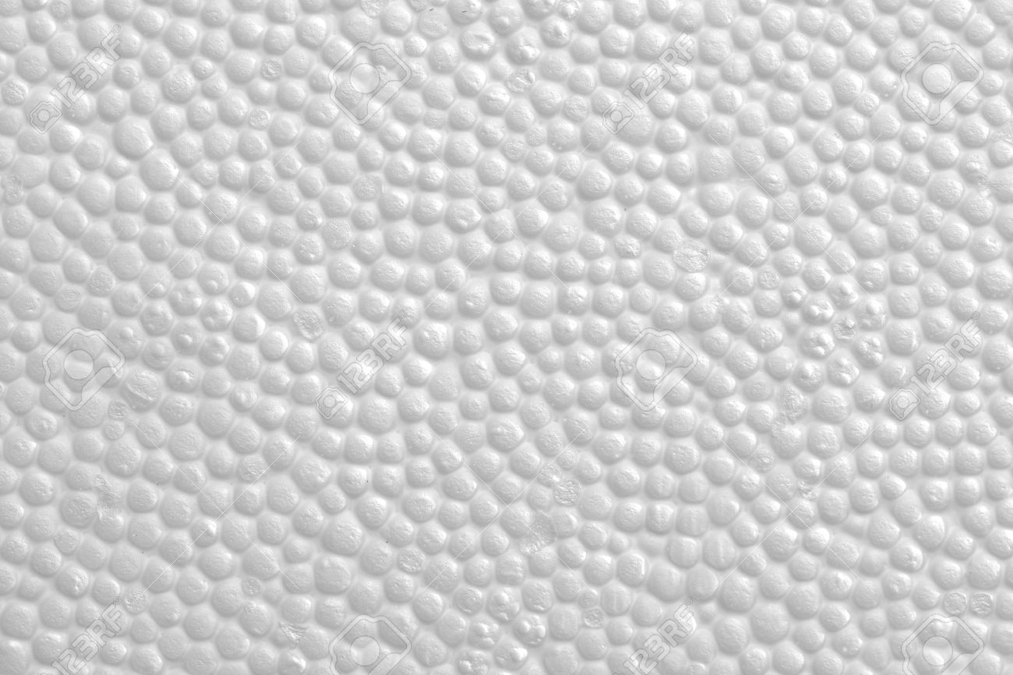
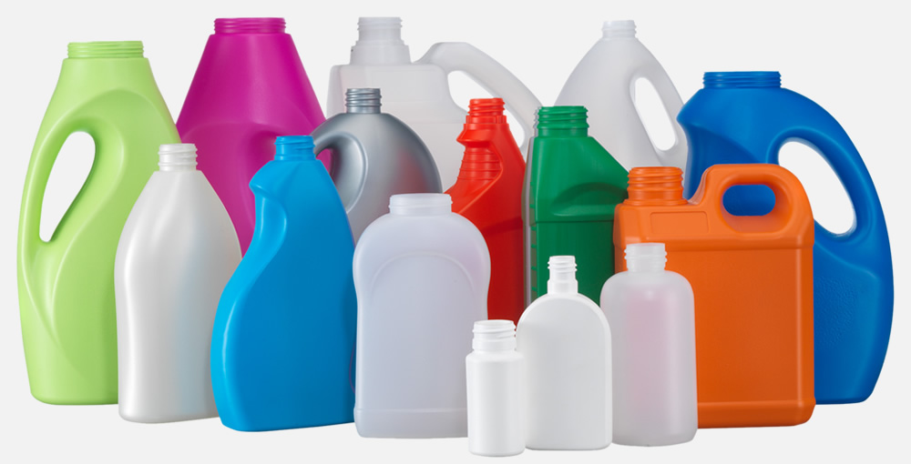
Ocean and Beach Plastics

Slide 5
Environmental Impact: Marine Organisms, Humans
Marine organisms mistake plastic for food
Organisms consume toxic plastic, impact endocrine system
Develop deformities/complications in physical state resulting in death, inability to reproduce
Human Consumption:
Humans- unaware/uninformed of endocrine disruption
Consume plastic intoxicated marine animals- certain fish, crabs, etc.
Recently humans have been found to carry plastic molecules in blood
Effects on marine organisms? Large pieces in stomachs of birds, fish, whales..

Slide 6
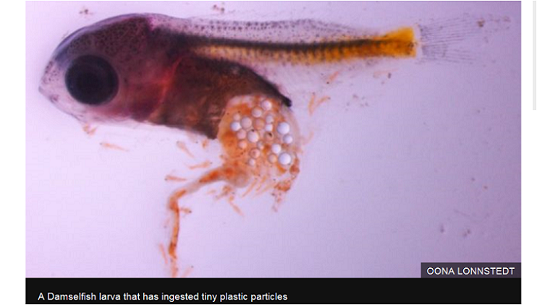
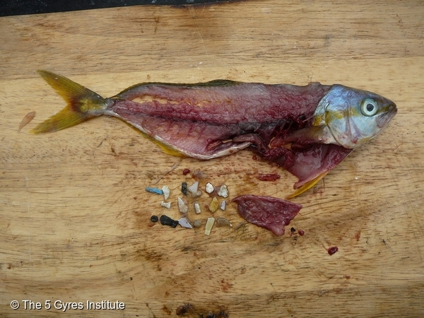
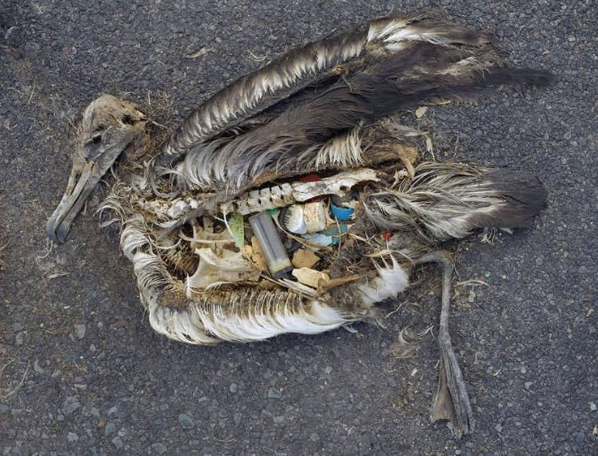
The effect of plastics on living organisms

Slide 7
Hypothesis
Our team hypothesizes that our research will discover high concentrations of plastic in marine environments along Southern California beachesand waterways due to population size, street and stream runoff and numerous ways in which plastics are used and then discarded.

Slide 8
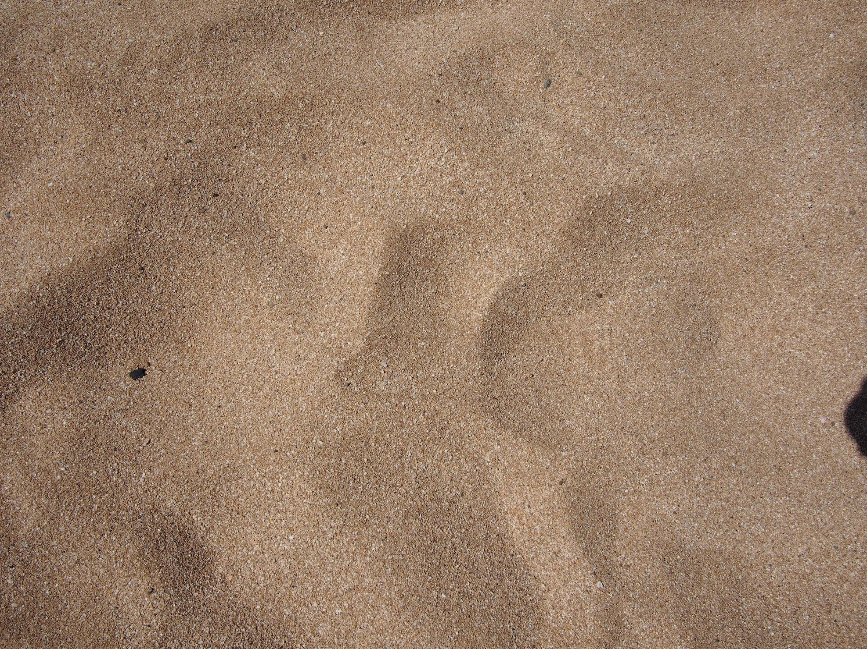
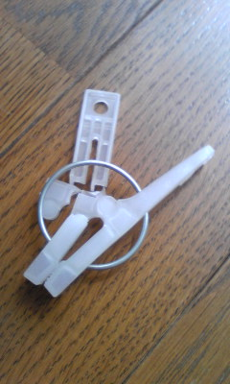
What`s this?

Slide 9
clothes pin

Slide 10
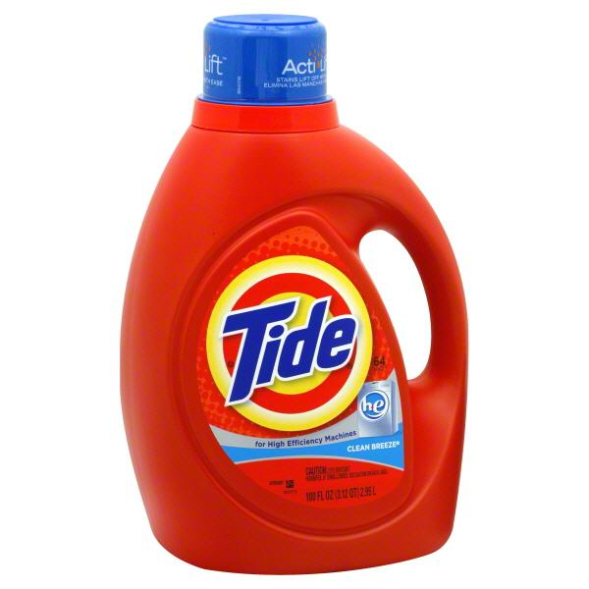
What`s this?

Slide 11
Detergent bottle

Slide 12
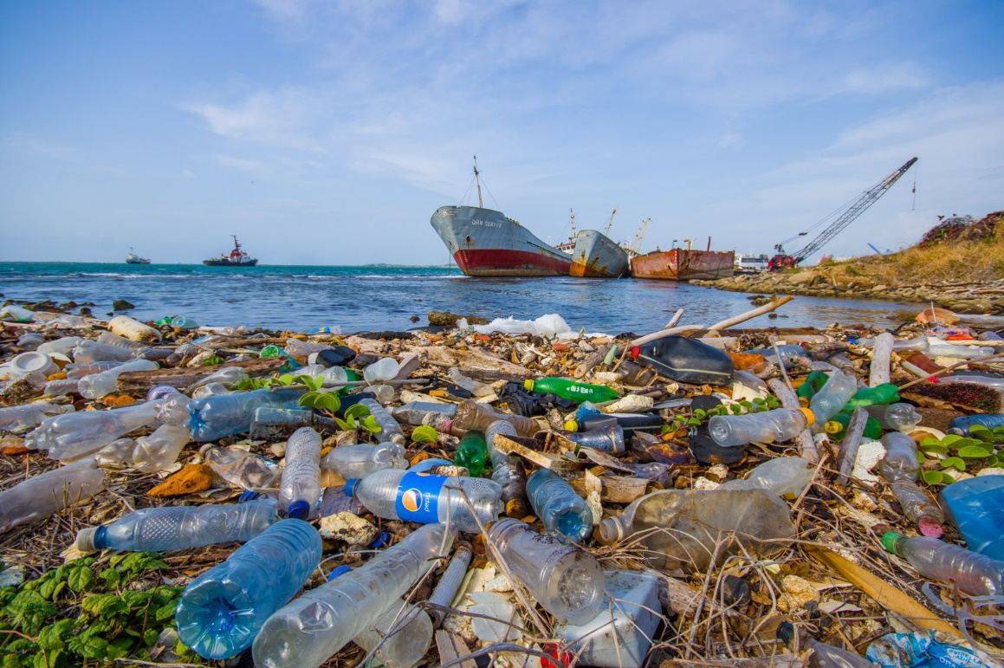
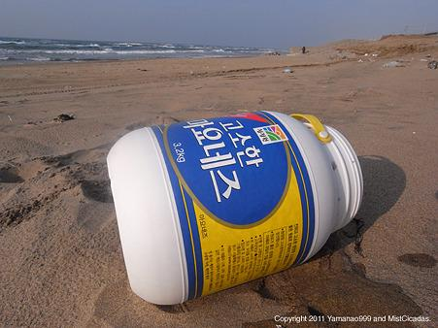
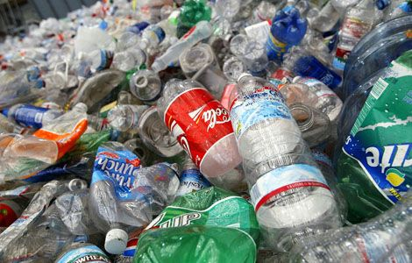

Slide 13
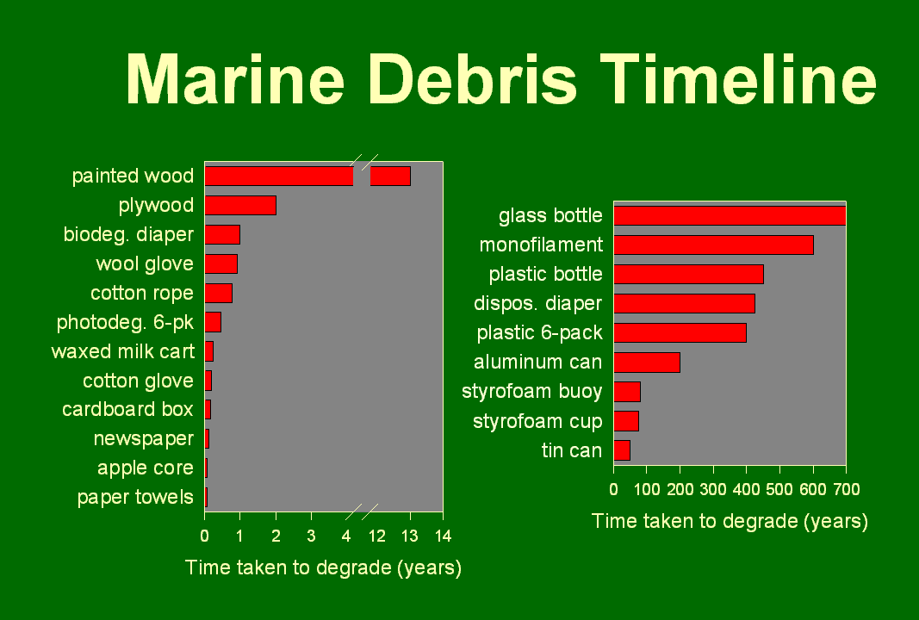

Slide 14
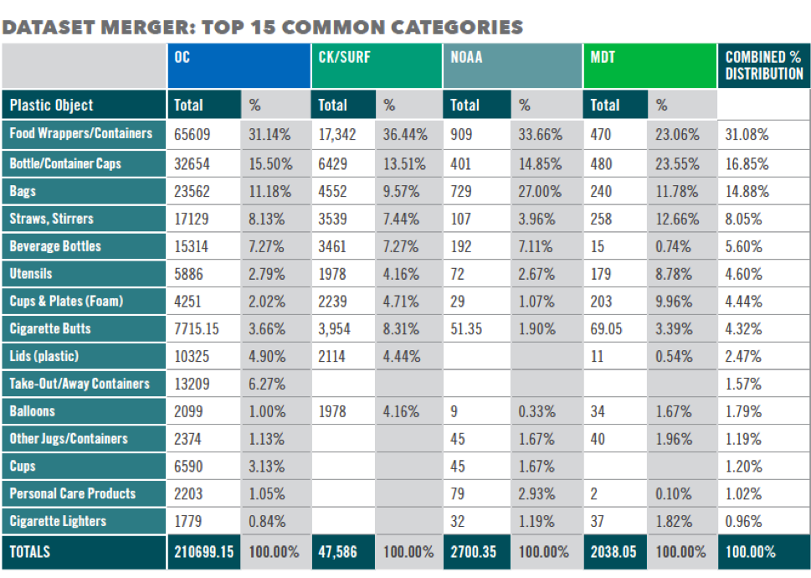

Slide 15
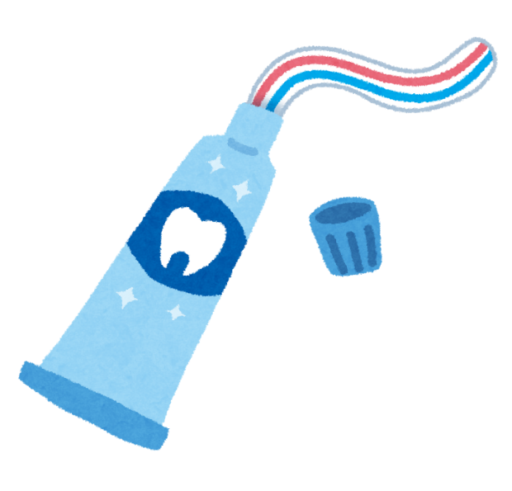

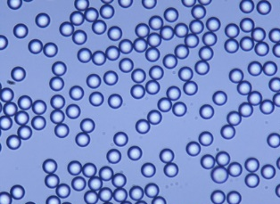
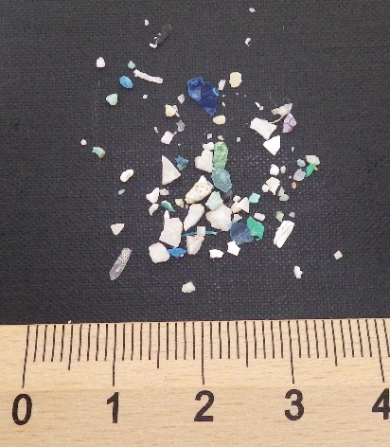
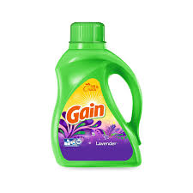
Methods of making
micro-plastics

Slide 16

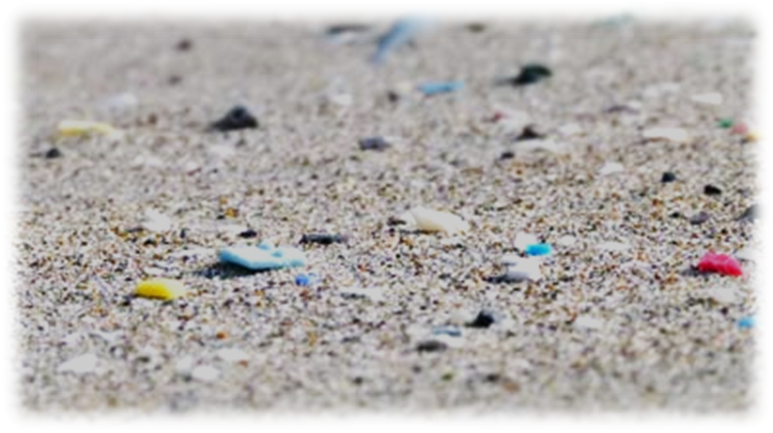
Where are they coming from?

Slide 17

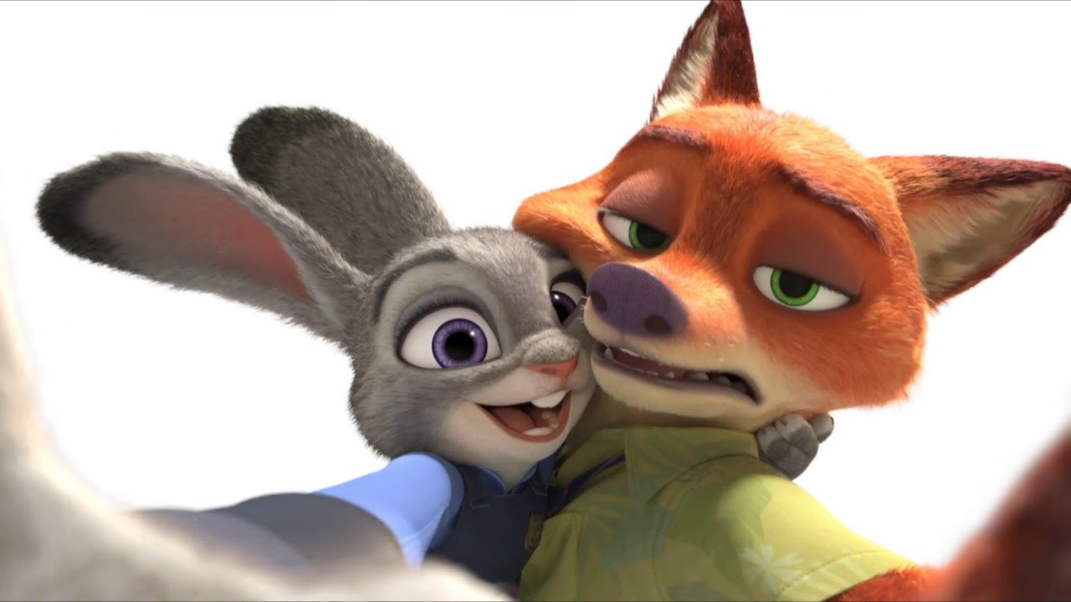
We don't exactly know!!!!!
Research needed!

Slide 18
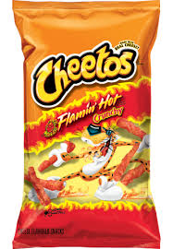
Sea debris
It says “Flamin’ Hot Cheetos"
Found in Japan but...It's from California!!!!!
beach

Slide 19

But...
pieces are too small
Can't read to determine origin
But we can check the chemical composition!!!

Slide 20
How much micro-plastic is in the world‘s oceans and on the beaches?

Slide 21
We don't know!!!!!
Research!

Slide 22
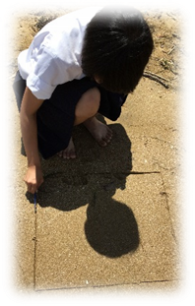
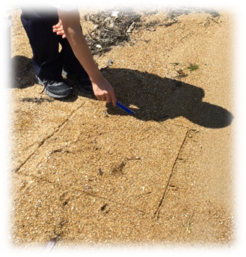
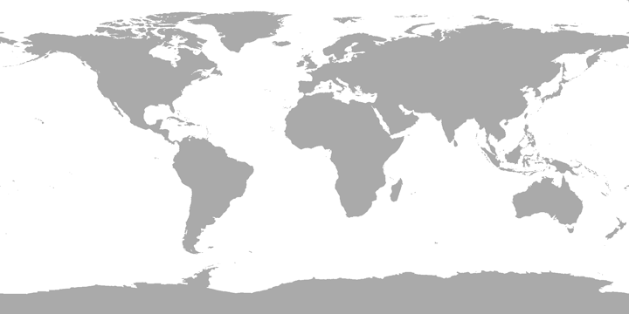
Purpose of our project:
*Investigate, collect data
*Analyze
*Propose solutions

Slide 23
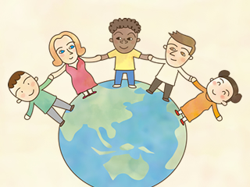
Let's collaborate. Japan, US and other countries. Who wants to join us?

Slide 24
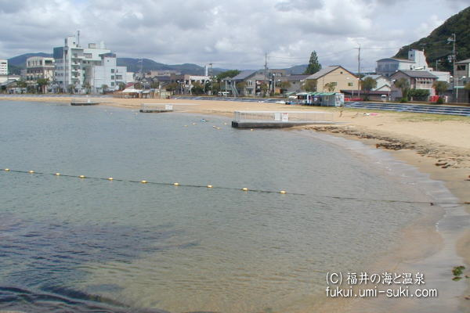
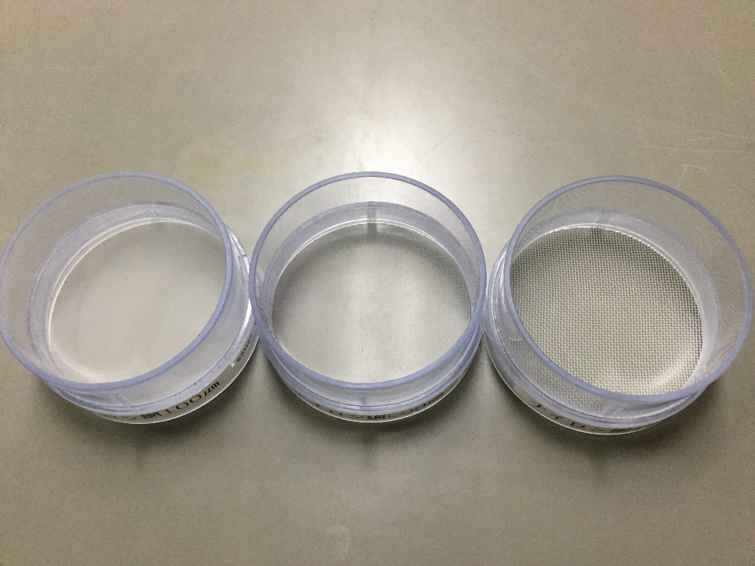
Research method for beaches
Survey Locations
Obama Bay, Japan, Mermaid Beach
Los Angeles, US. LA Harbor, Redondo, Dockweiler, Long Beach & Cabrillo Beach

Slide 25
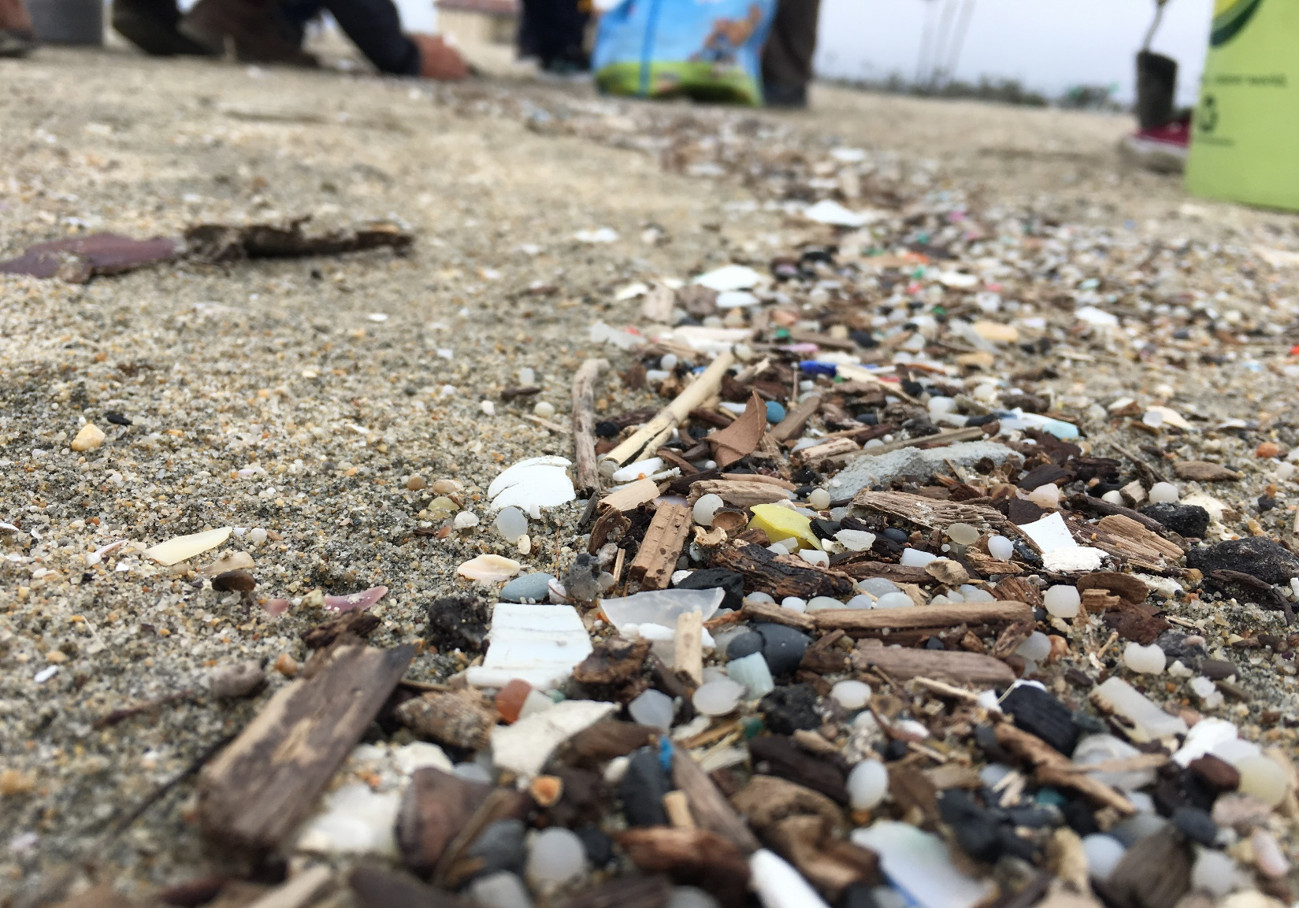
Long Beach, CA tideline

Slide 26
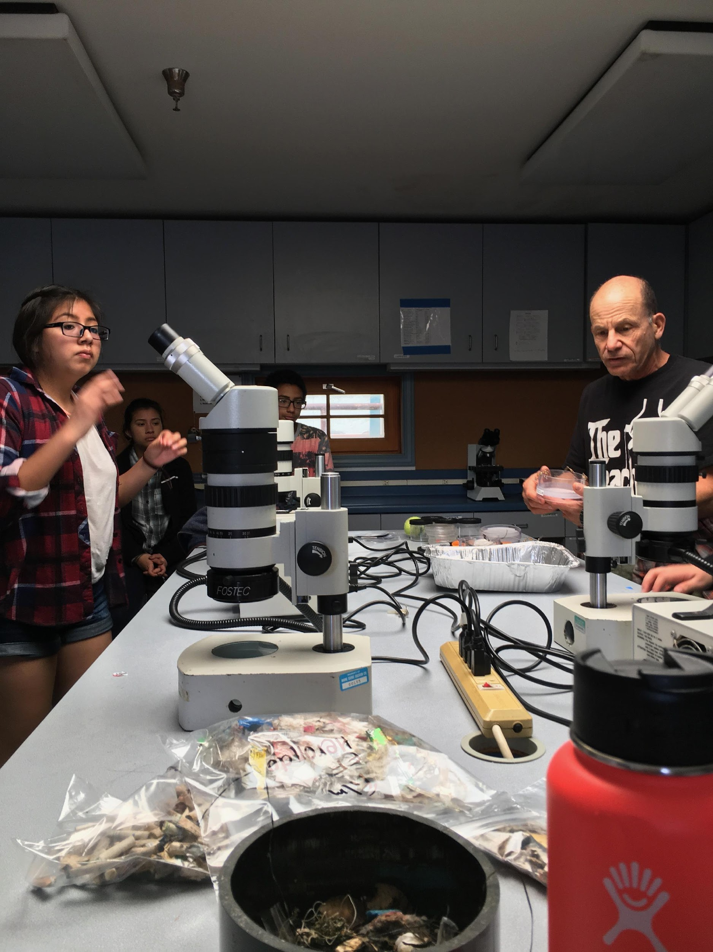
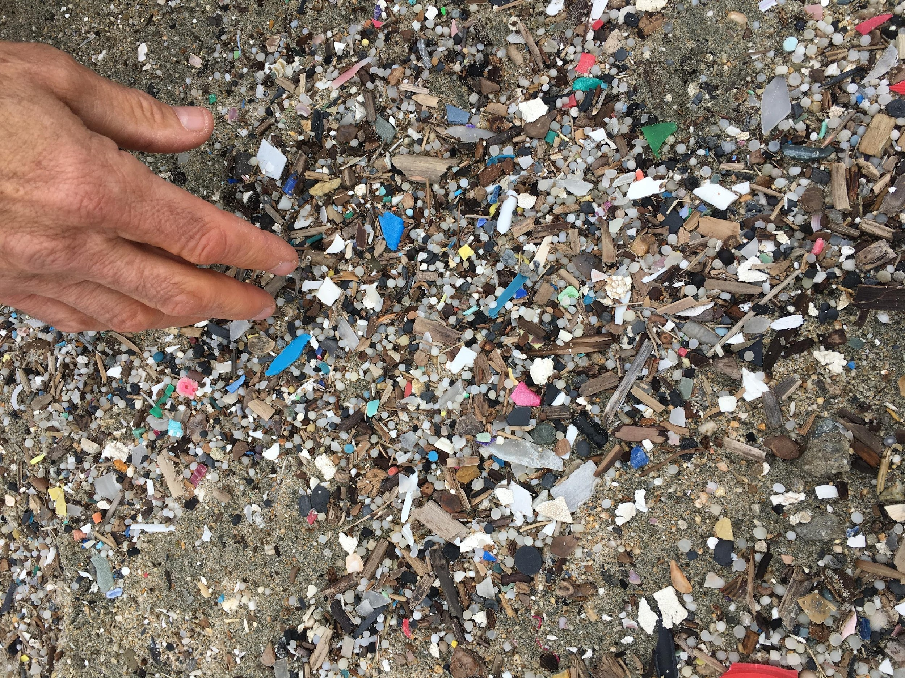
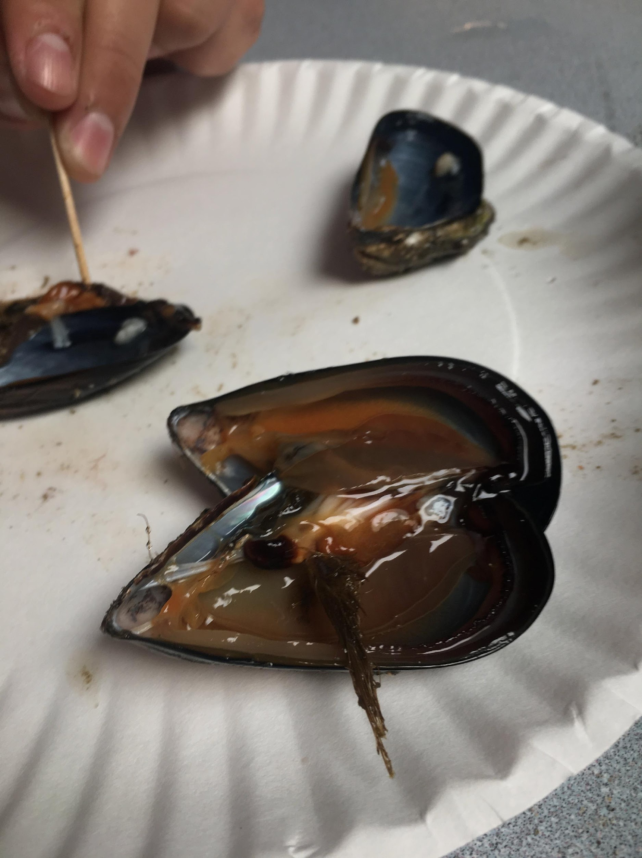
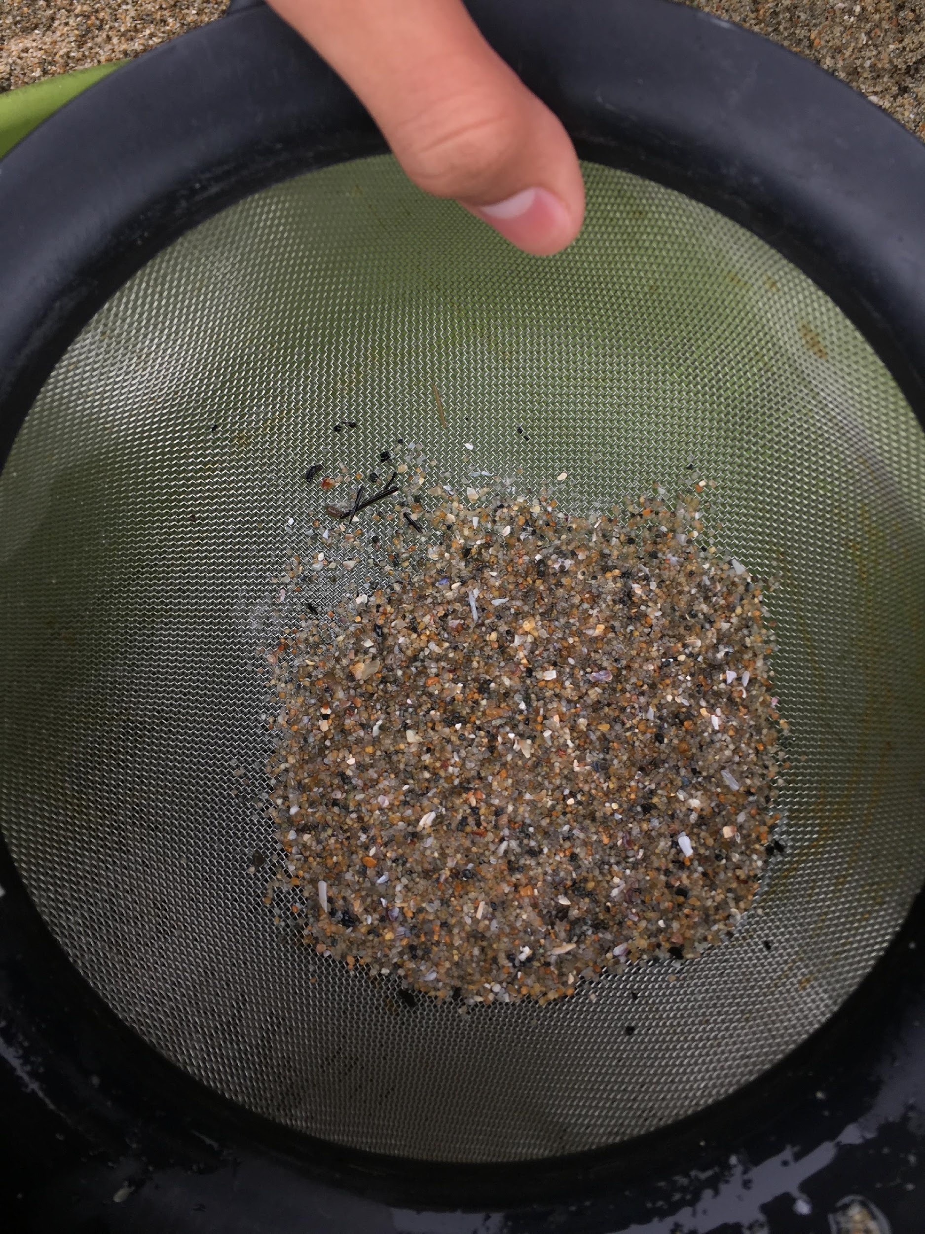
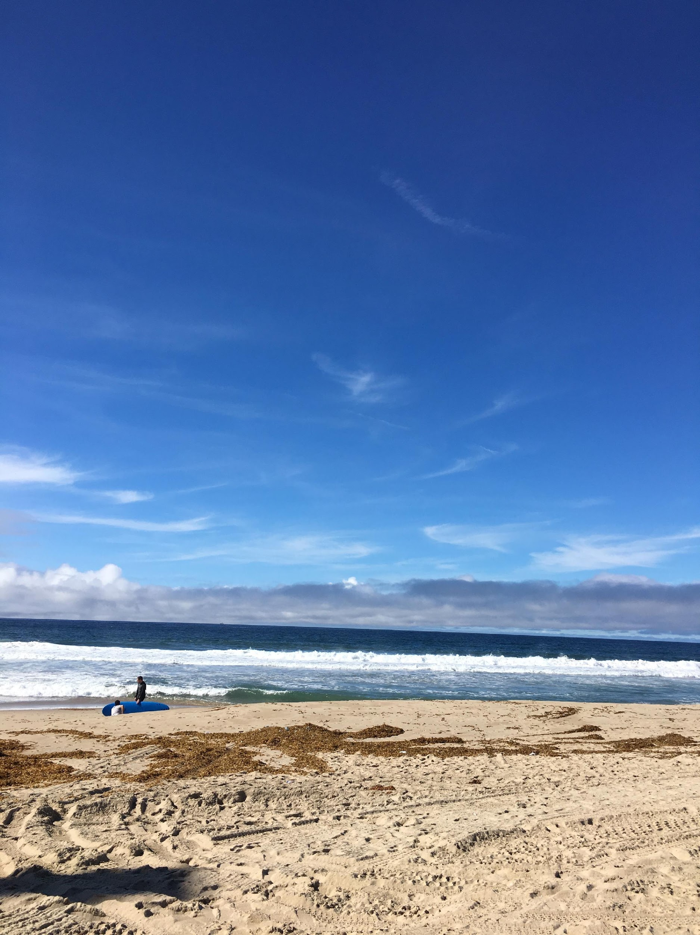
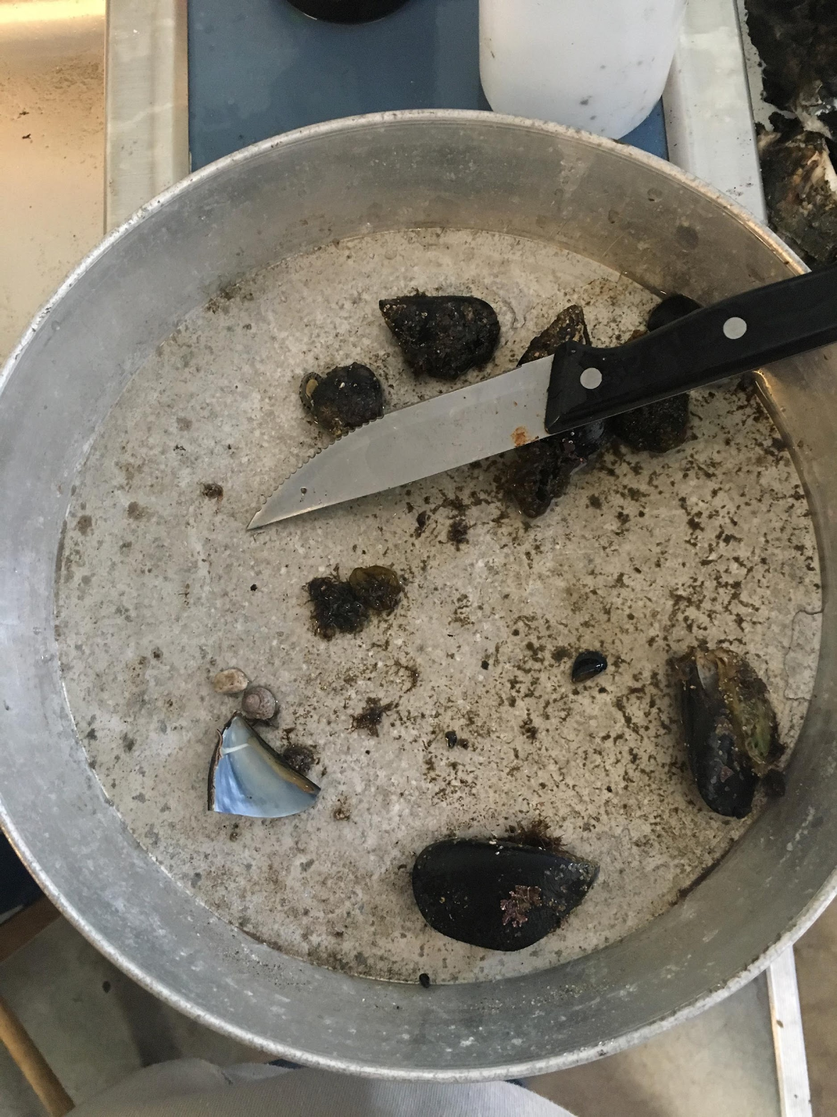
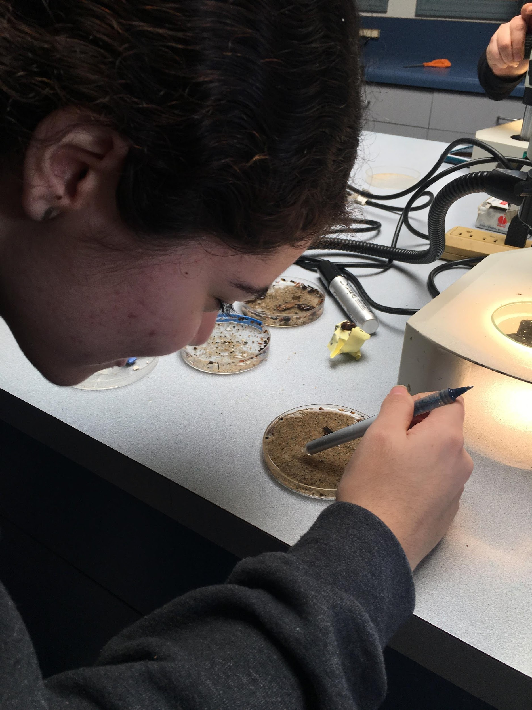
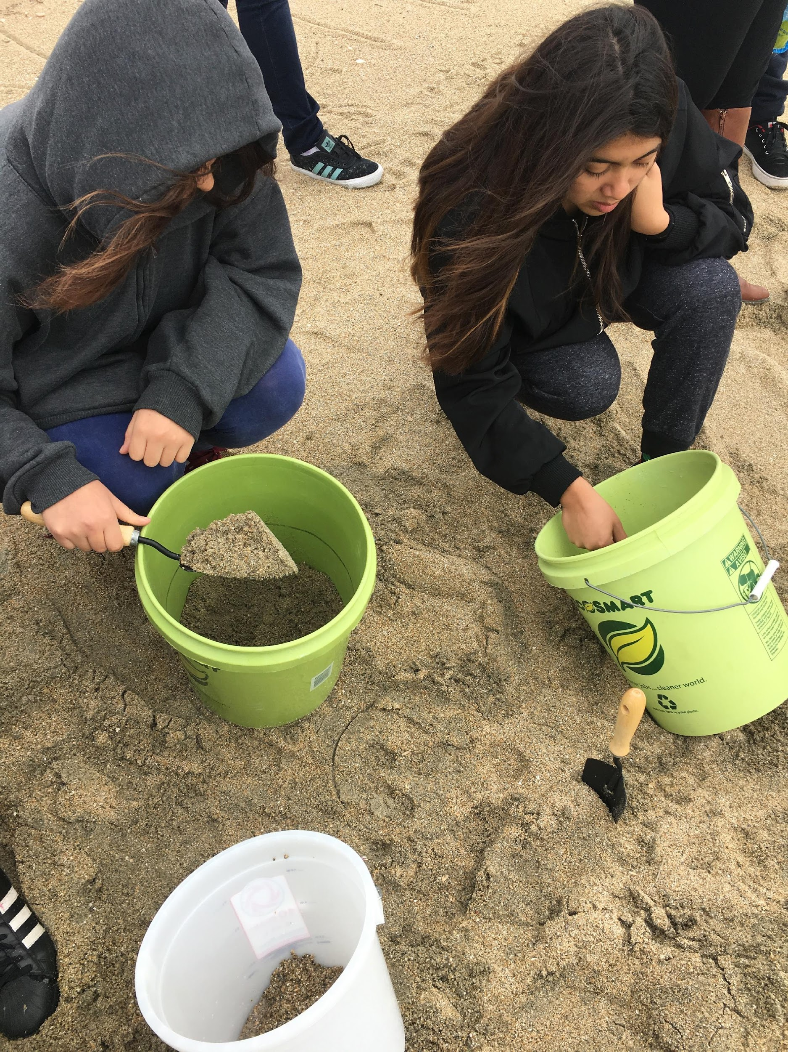
Sifting /sorting procedures for discovering plastic fragments, film. Using sieves with mesh sizes 1 mm , 500 um , 100 um

Slide 27
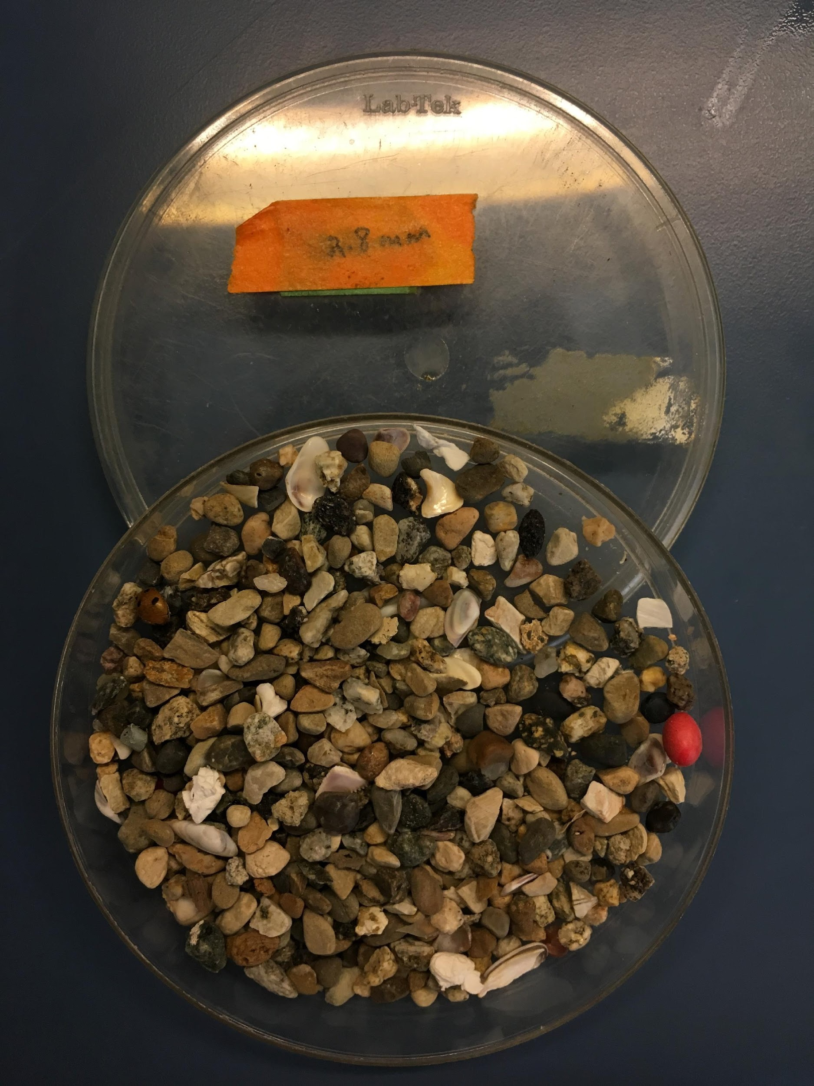
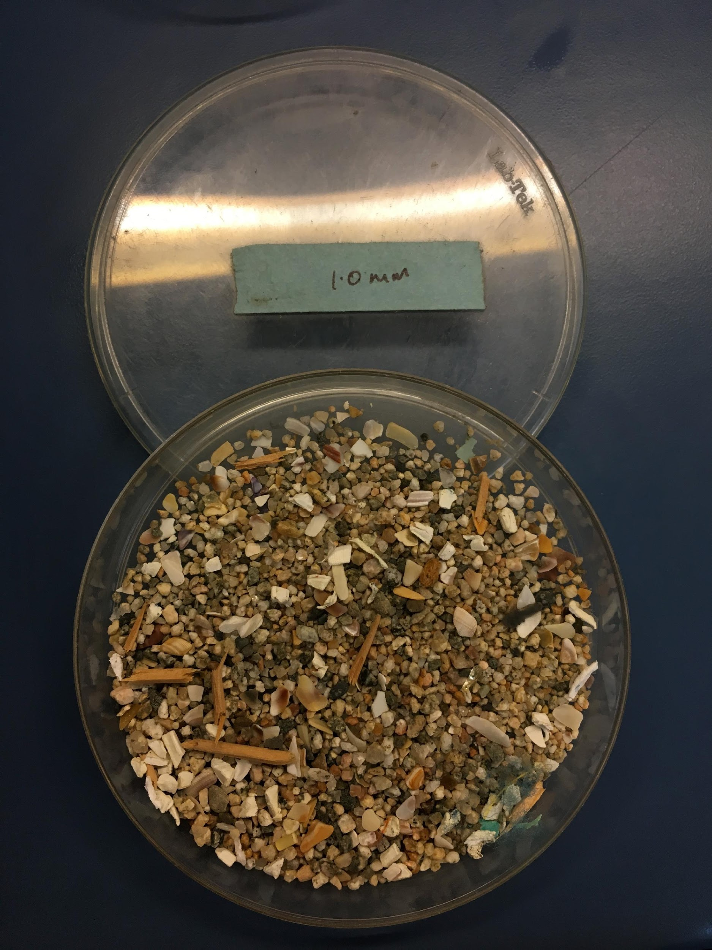
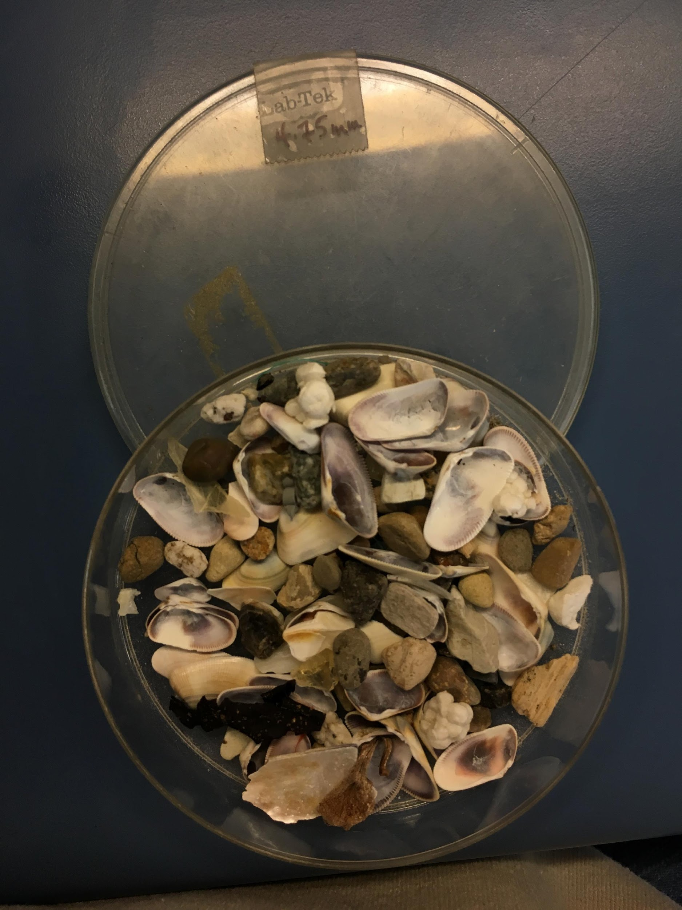
Petri dishes with sorted samples.

Slide 29
How Samples are Obtained
Beach collection samples
Beach sand is collected and then passed thru 100 ∐m, 500 ∐m, 1mm fine mesh sieves (strainers)
Plastic floats in water, is extracted, examined under microscope, removed and counted.
Water collection samples
Sieves are pulled thru shoreline or harbor
Particulates flushed out
Collected on filter paper, examined thru microscope, removed and counted.

Slide 30
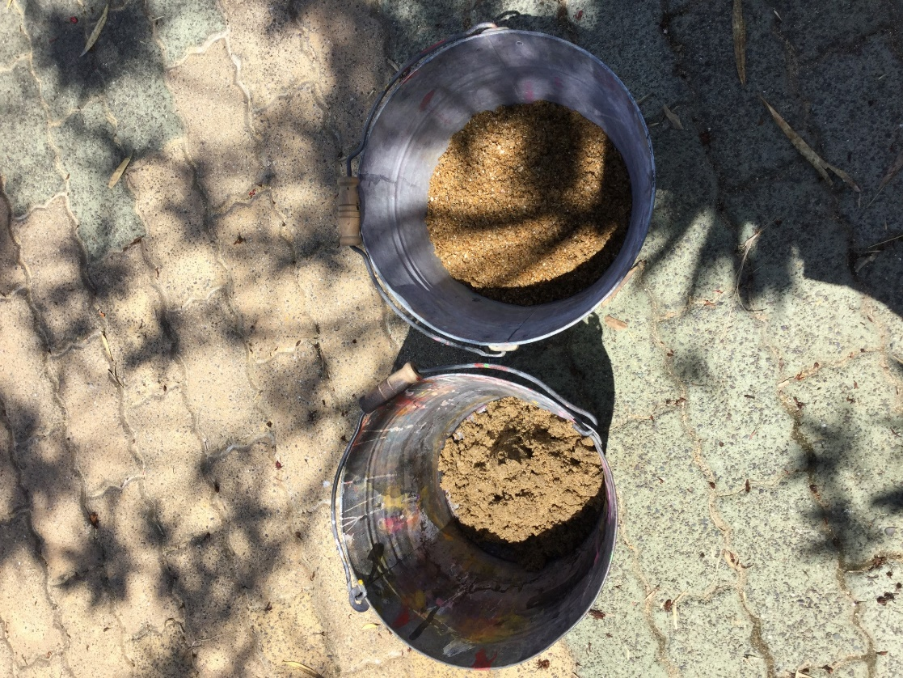
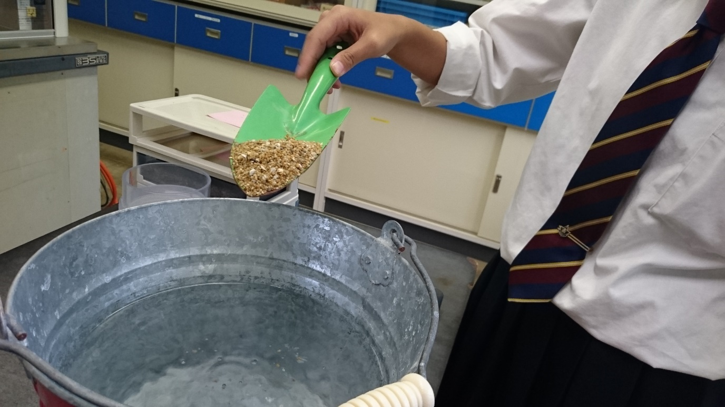


Slide 31




Slide 32




Slide 33


Japanese team flushed micro beads from
living oysters

Slide 34


Collection Results. Ocean Water

Slide 35

LA Team discovered these plastic and synthetic fibers in Long Beach harbor water

Slide 38

Datasheet example. 12/2016 Cabrillo sampling

Slide 39



SOLUTIONS:
Reduce plastic use in our life! {food packaging!!}
Re-cycle existing plastic. The science exists to do this.
Substitute biodegradable items for plastic
{Paper packaging, bamboo, cornstarch bags, packing peanuts, eating utensils}
Make the corporations clean up their pollutants.
New, stronger & enforced government EPA regulations while creating jobs, new inventions

Slide 40

Japanese Microplastics team, Wakasa HS in Obama City sharing research and teaching junior high school students

Slide 41


Slide 42
Recent Scientific Articles on Marine Microplastics & Impact
Marine Pollution Bulletin E. Besseling a,b,⇑, et al
Microplastic in a macro filter feeder: Humpback whale Megaptera novaeangliae Science Alert
Tiny Animal May Solve a Big Pollution Problem
The humble mealworm can live on styrofoam
NEWSER
By 2050, our oceans will hold more plastic than fish
First detection of seven phthalate esters (PAEs) as plastic tracers in superficial neustonic/planktonic samples and cetacean blubber† Matteo Baini,*a
ScienceDirect Marine Environmental Research
Exploring the potential of large vertebrates as early warning sentinels
of threats to marine ecosystems, human health and wellbeing
If you eat seafood, you’re eating thousands of pieces of plastic
Seafood fans are ingesting up to 11,000 tiny pieces of plastic a year with unknown health effects, study says.
Contaminants in the Urban Environment: Microplastics Yun-Ya Yang,

Slide 43



Student Microplastic team.
Wakasa HS, in Obama City, Japan
Beach
research
team
Oyster
research
team
Ocean
research
team

Slide 44

Student Microplastic Team
Animo HS, in Los Angeles, CA

