Slide 1
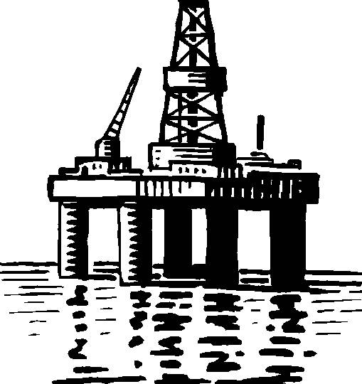
Oil Plume Experiment
By Thomas

Slide 2
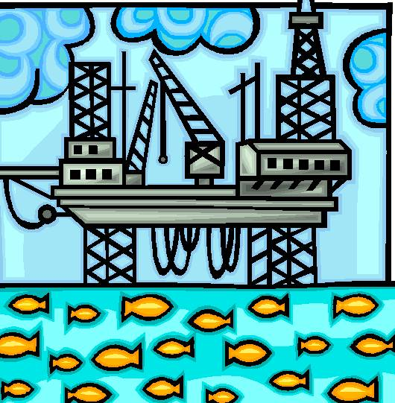
Introduction
Hello, I’m Thomas. I’ve made a power point about the experiment I did in class. In the power point you will learn about oil plumes, dispersants, and the experiment I did.
The oil spill in the Gulf of Mexico is a disaster so please pay attention.

Slide 3
The Purpose
The purpose of the experiment was to see the 2-inch layer of oil on the bottom of the Gulf of Mexico. We also saw an oil Plume appear. An oil plume is a layer of oil in the water column. Dispersants push down the oil and the scientists think that it is gone, but it is just pushed down under the surface.

Slide 4
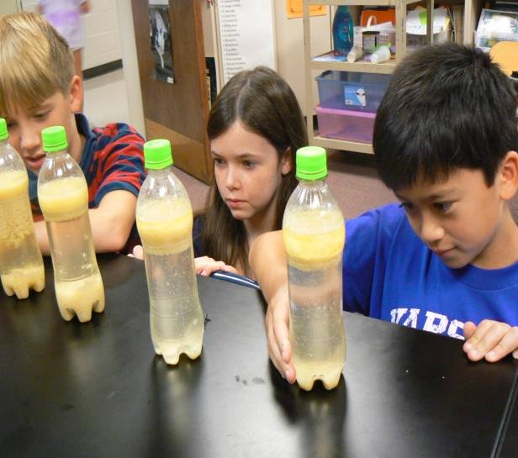
Dispersants
Dispersants are chemicals that spread out the oil and make the oil easy to collect. In the experiment the mustard was the dispersants and the mustard pushed the oil to the bottom of the gulf.

Slide 5
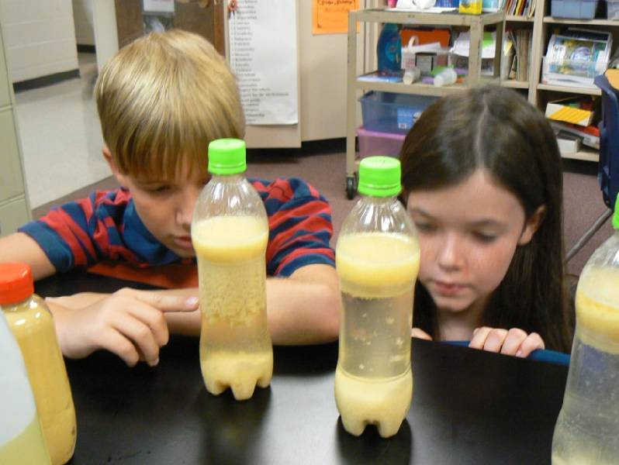
Layer at the bottom
The layer at the bottom of the ocean is very dangerous. The animals that are on the ocean like crabs get smothered with oil and die then the animals that eat them die and all the way up the food chain.

Slide 6
The Process
First, I got empty water bottles and filled them with water and cooking oil. Next, I put mustard in the bottles. Then I shook the bottle until it was very murky. Then, I waited for about an hour. Last, I saw the results that you see on the next slide.

Slide 7
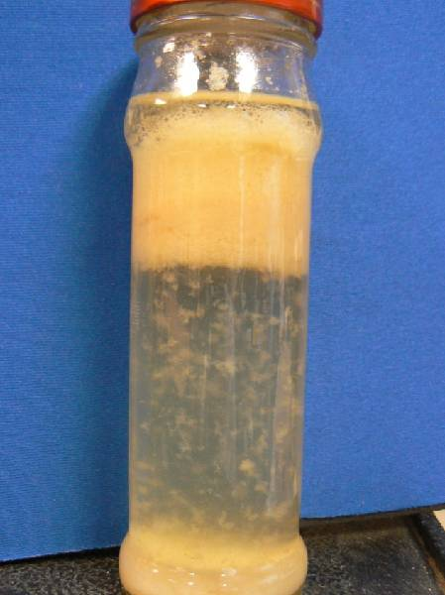
Results
Oil Plume
The results are this
Heavy oil being pushed down
2-inch layer

Slide 8
What I learned
I learned that Dispersants can push oil down but can not completely eliminate oil. I also learned that oil under the surface of the water is called an oil plume. I learned how the layer of oil at the bottom of the ocean affects the food chain. I hope you learned as much as I did! I hope that you liked the Power Point!

